Slide 1


Opioid / Substance Misuse Conference
Marion, Illinois – July 18, 2019
Adee Athiyaman, PhD, and Chris Merrett, PhD
Illinois Institute for Rural Affairs
Western Illinois University
Macomb, IL, 61455 a-athiyaman@wiu.edu cd-merrett@wiu.edu
The Intersection of Opioid & Substance Misuse in the Workplace and
Economic Development
Small Towns + Big Places

Slide 2
Purpose and Premise
Purpose:
  Measure workforce implications and economic development impacts of opioid misuse in Illinois.
Premise:
  Research on opioid misuse has typically emphasized:
    Public health issues.
    Individual health, addiction, and overdose related consequences.
    Criminal justice implications.
  Economic development impacts have received less attention.
Consequently, this presentation focuses on:
  Workforce development implications of opioid misuse.
  Economic development consequences of opioid misuse.
  Demographic impacts affecting rural and downstate Illinois.

Slide 3
Presentation Argument
Total Illinois population declined slightly over the last decade.
  12,940,000 (2010) versus 12,741,080 (estimated 2018)
However, there are big changes within this stagnant population:
  Younger age cohorts shrinking fastest as a proportion of the total Illinois population.
  Rural and downstate places are doing worse than urban areas.
Population dynamics shrink the total size of our workforce.
  Opioid misuse exacerbates the problem of our shrinking workforce.
We can measure the economic impacts of the opioid misuse epidemic on the economic productivity of Illinois workforce.

Slide 4
Outline
Illinois Demographic Change
Opioid Use and the Workforce
Measuring the Economic Impacts of Opioid Misuse
Conclusions

Slide 5
I. Illinois Demographics

Slide 6
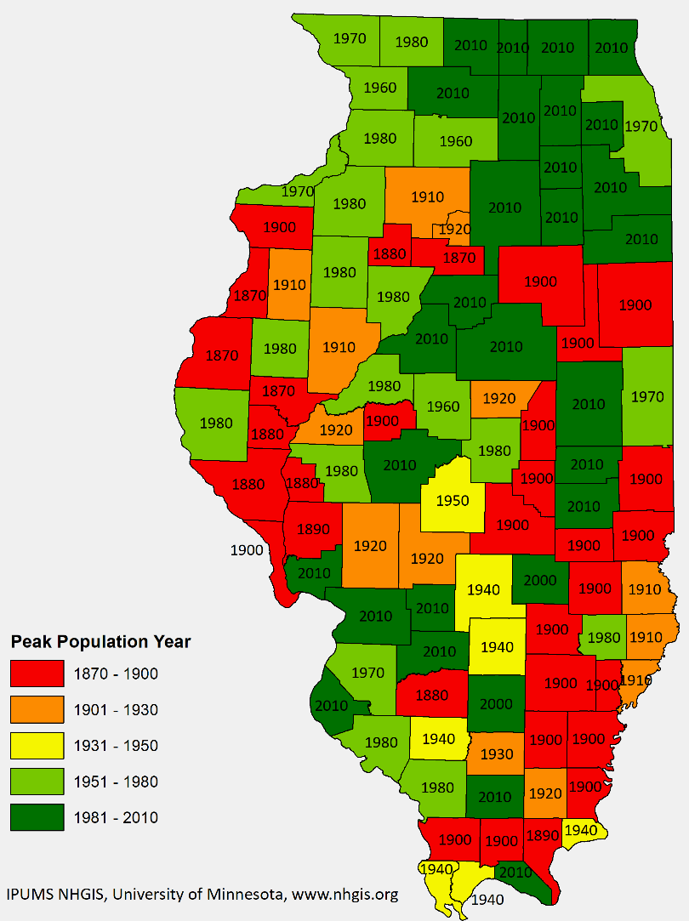
I. Demographics
Year of Population Peak by County
Many rural Illinois county populations peaked more than a century ago.
Depopulation has been an ongoing issue for downstate and rural Illinois for a long time.
Rural depopulation drivers:
  Ag mechanization.
  birthrate decline.
  Rural to urban migration.
Economically diverse rural counties hosting manufacturing, or public institutions (e.g. colleges) have retained more of their population.

Slide 7
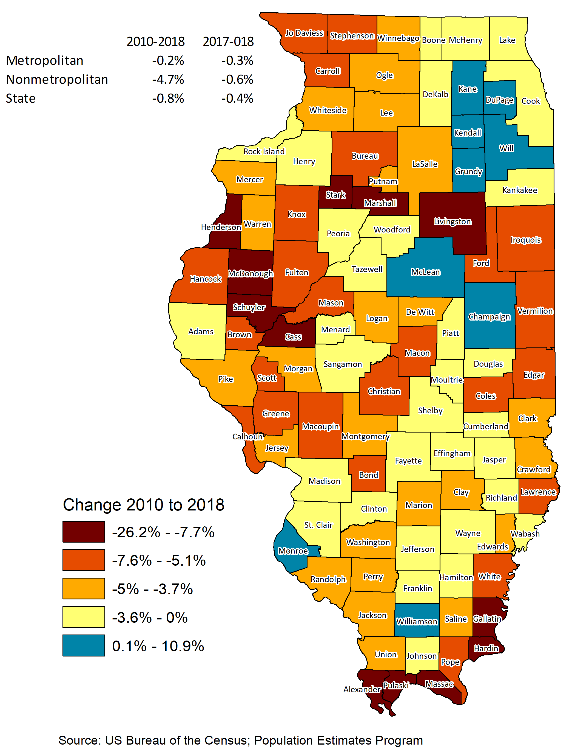
I. Demographics
Percent Population Change by County, 2010 to 2018.
Greatest decline occurring in rural counties.

Slide 8
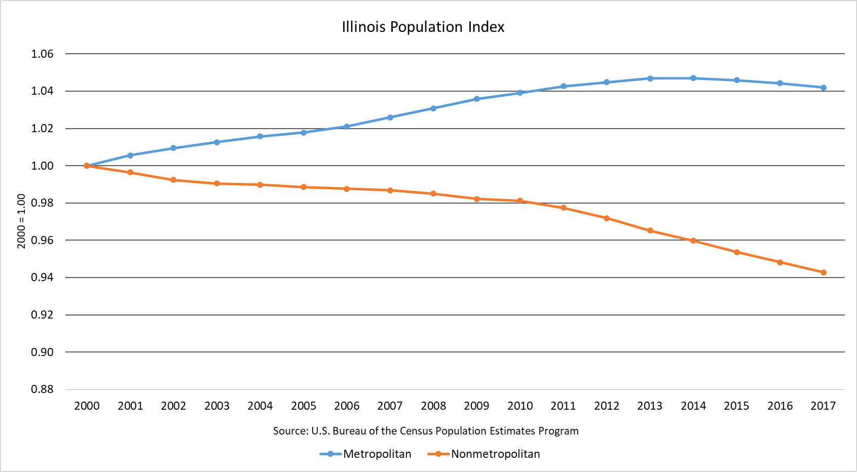
I. Illinois Rural vs Urban Population Growth Index
Illinois has divergent urban versus rural growth rates.

Slide 9
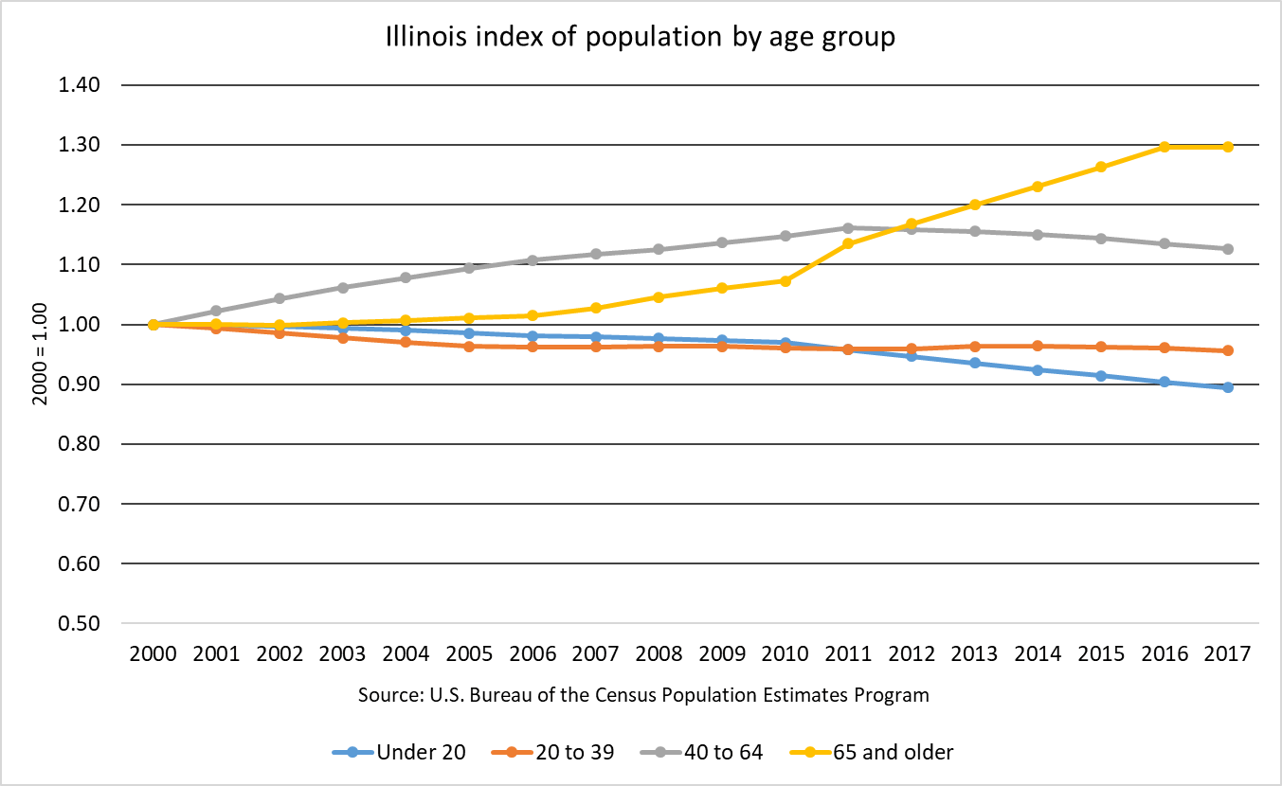
I. Illinois Population Growth Index by Age Cohorts
65+
<20
Fastest growing segment of Illinois population is 65 and older.
Fastest shrinking segment of the Illinois population is under 20.

Slide 10
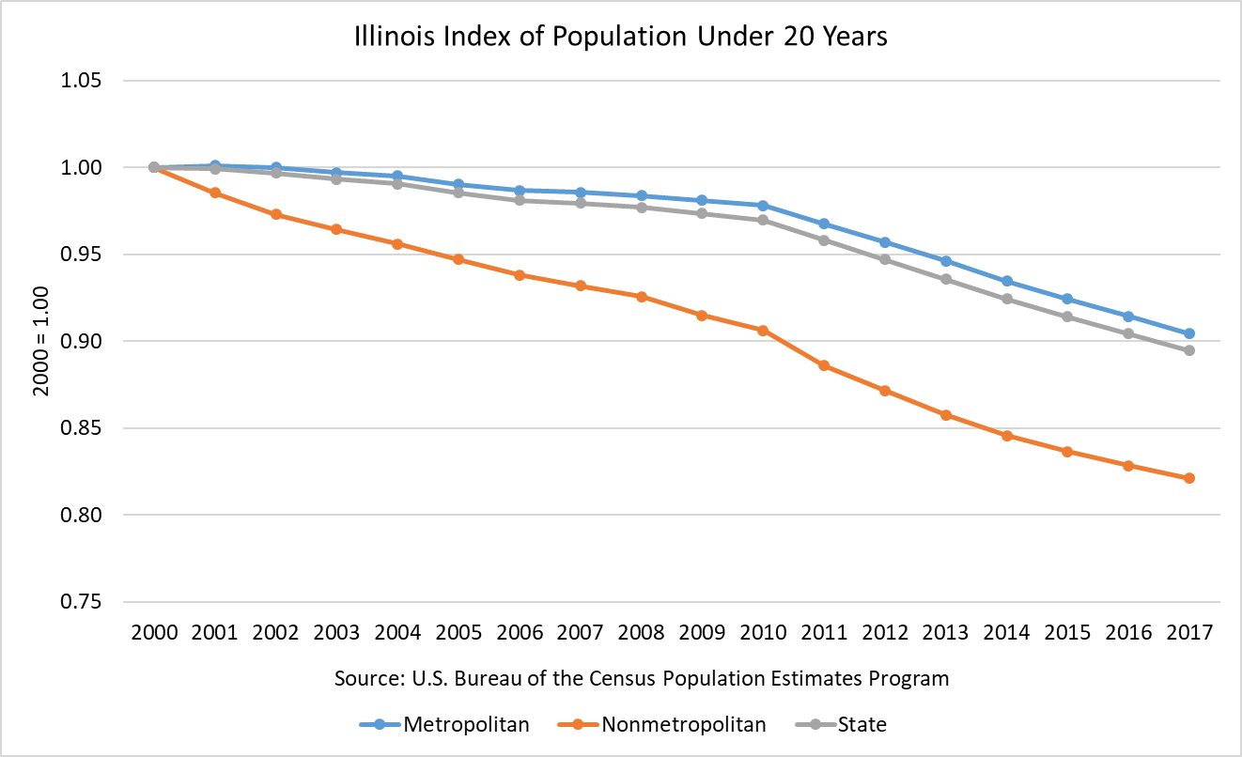
I. Illinois Population Growth Index, < 20 Years
The fastest shrinking cohort is under 20 (i.e. future workforce).
The rural under 20 cohort is shrinking faster than urban cohort.
Rural <20

Slide 11
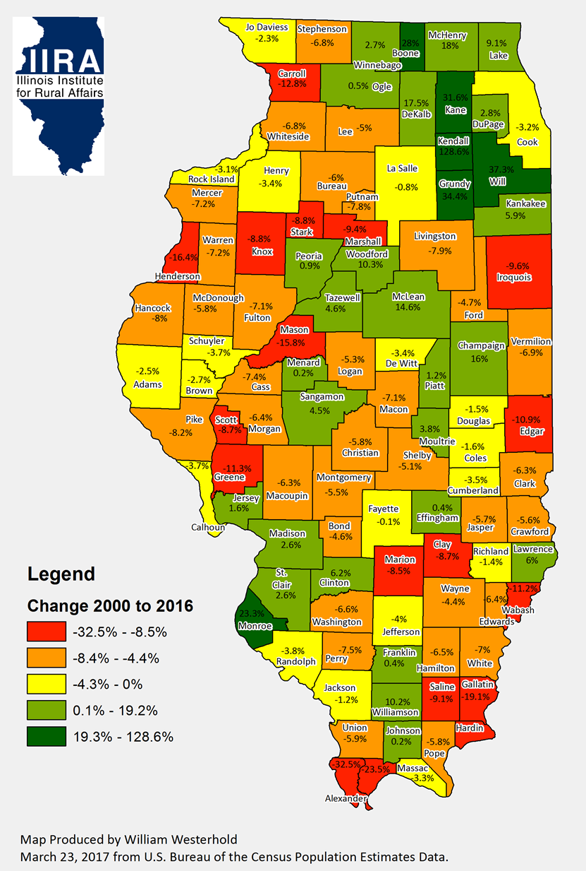
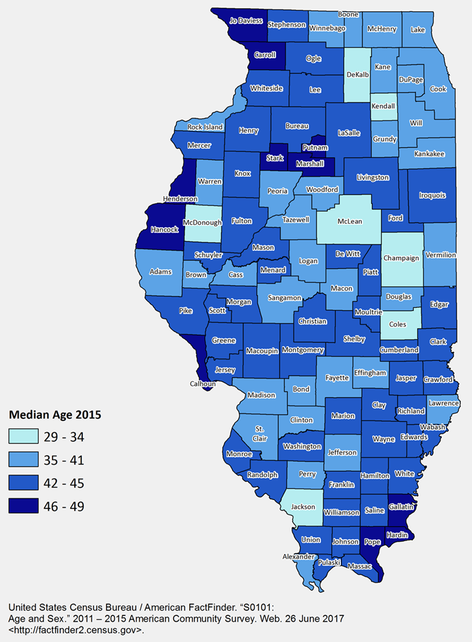
Rural regions are losing people.
Rural regions have higher median age.

Slide 12
II. Opioid Use and the Workforce

Slide 13
II. Opioids and the Workforce
Overall population dynamics directly affect the Illinois workforce.
  As the Illinois population has declined and as the proportion of young people has declined, so has the Illinois labor force.
Increased use of opioids exacerbates a pre-existing situation to undermine workforce productivity.
  Financial costs imposed on healthcare system.
  Workers incarcerated.
  Absenteeism.
  Job openings remain unfilled.
  Worker turnover and retraining costs.
    Downstate and rural counties disproportionately rely on manufacturing and other jobs where drug testing frequently occurs.

Slide 14
II. Labor Force by Employment Status and Age
Illinois | 2013 | 2015 | 2017 | ACGR
Labor force | 6,725,720 | 6,676,518 | 6,662,189 | -0.24%
Employed | 6,072,540 | 6,195,235 | 6,241,958 | 0.69%
Unemployed | 653,181 | 481,283 | 420,230 | -11.0%
Out of labor force | 3,480,229 | 3,563,540 | 3,587,332 | 0.76%
Population (16+) | 10,205,949 | 10,240,058 | 10,249,521 | 0.11%
Population (Over 65) | 1,740,088 | 1,828,225 | 1,947,595 | 2.82%
United States | 2013 | 2015 | 2017 | ACGR
Labor force | 159,531,695 | 161,641,855 | 164,676,605 | 0.79%
Employed | 145,234,043 | 150,626,642 | 155,556,856 | 1.72%
Unemployed | 14,297,652 | 11,015,214 | 9,119,749 | -11.2%
Out of labor force | 91,304,304 | 94,525,903 | 95,887,643 | 1.22%
Population (16+) | 250,835,999 | 256,167,758 | 260,564,248 | 0.95%
Population (Over 65) | 44,663,990 | 47,732,480 | 50,815,712 | 3.23%
Source: American Community Survey, 1 year estimates.

Slide 15
II. Labor Force less than 65 Years of Age
Illinois | 2013 | 2015 | 2017
Available labor force under 65 | 8,465,861 | 8,411,833 | 8,301,926
Percentage change | -0.09% | -0.49% | -0.58%
Labor force participation | 6,421,687 | 6,357,711 | 6,307,499
United States | 2013 | 2015 | 2017
Available labor force under 65 | 206,172,009 | 208,435,278 | 209,748,536
Percentage change | 0.35% | 0.51% | 0.49%
Labor force participation | 151,851,611 | 153,393,128 | 155,572,080
Source: Author’s estimates, based on ACS data.

Slide 16
Illinois Labor Market Structure | Total Number of Persons Employed 16 years and older |  |  |  | Percent of Persons Employed 16 years and older
 | Illinois | Illinois Metro | Illinois Nonmetro |  | Illinois | Illinois Metro | Illinois Nonmetro
Employed population 16 years and over | 6,134,121 | 5,473,790 | 660,331 |  | 100% | 100% | 100%
Agriculture, forestry, fishing and hunting, and mining | 65,146 | 32,346 | 32,800 |  | 1.1% | 0.6% | 5.0%
Construction | 317,245 | 277,230 | 40,015 |  | 5.2% | 5.1% | 6.1%
Manufacturing | 763,429 | 660,212 | 103,217 |  | 12.4% | 12.1% | 15.6%
Wholesale trade | 187,477 | 169,258 | 18,219 |  | 3.1% | 3.1% | 2.8%
Retail trade | 670,576 | 591,403 | 79,173 |  | 10.9% | 10.8% | 12.0%
Transportation and warehousing, and utilities | 370,802 | 329,515 | 41,287 |  | 6.0% | 6.0% | 6.3%
Information | 121,338 | 112,714 | 8,624 |  | 2.0% | 2.1% | 1.3%
Finance and insurance, and real estate and rental and leasing | 448,924 | 417,470 | 31,454 |  | 7.3% | 7.6% | 4.8%
Professional, scientific, and management, and administrative and waste management services | 709,106 | 673,410 | 35,696 |  | 11.6% | 12.3% | 5.4%
Educational services, and health care and social assistance | 1,404,905 | 1,242,454 | 162,451 |  | 22.9% | 22.7% | 24.6%
Arts, entertainment, and recreation, and accommodation and food services | 556,087 | 508,644 | 47,443 |  | 9.1% | 9.3% | 7.2%
Other services, except public administration | 291,022 | 259,439 | 31,583 |  | 4.7% | 4.7% | 4.8%
Public administration | 228,064 | 199,695 | 28,369 |  | 3.7% | 3.6% | 4.3%
Source: U.S. Bureau of the Census, Table DP03 Selected Economic Characteristics, downloaded October, 29 2018.

Slide 17
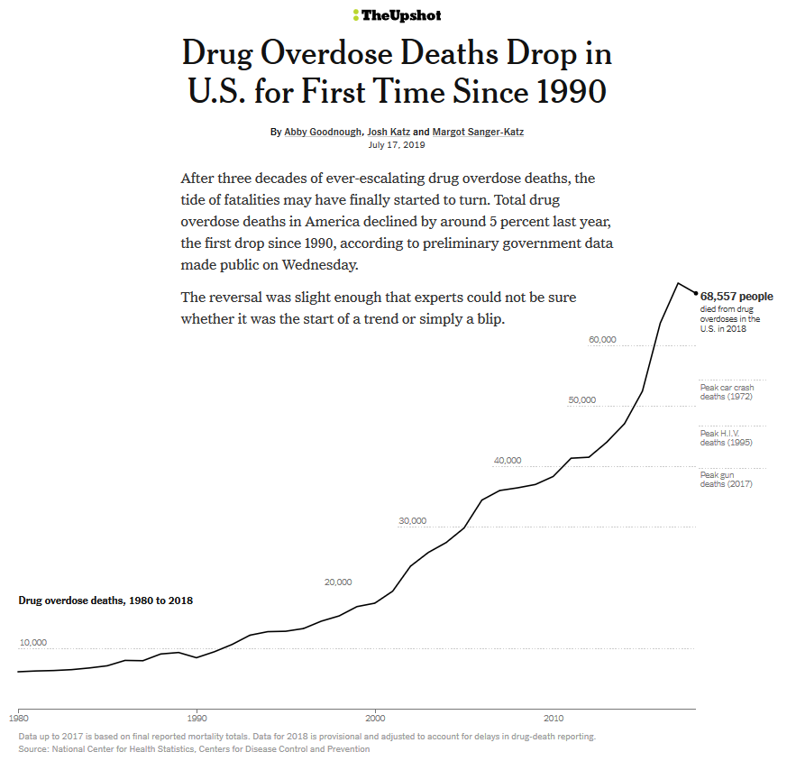

Source: https://www.nytimes.com/interactive/2019/07/17/upshot/drug-overdose-deaths-fall.html.

Slide 18
II. Growth Rates of Drug Overdose Deaths, by Opioid Category
Time Period | Natural and Semi-Synthetic Opioids | Synthetic Opioids | Heroin
US
1999 – 2005 | 12.37% | 47.02% | 0.41%
2006 - 2011 | 10.21% | 34.43% | 12.12%
2012 - 2017 | 5.27% | 52.27% | 19.21%
Illinois
1999 - 2005 | 13.39% | 15.88% | 8.18%
2006 - 2011 | 8.66% | -20.17% | 19.62%
2012 - 2017 | 20.75% | 40.14% | 29.69%
Source: Kaiser Family Foundation’s State Health Fact.

Slide 19
II. US Opioid Overdose Deaths Rates, Prime-Age Worker Population (rates per 100,000)
Age | Prescription Opioids* | Heroin
25-34 | 7.7 | 11.3
35-44 | 9.2 | 9.0
45-54 | 10.1 | 7.0
*Prescription opioid-related death rates go up as people get older.
Source: CDC’s Annual Surveillance Report of Drug Related Risks and Outcomes, 2018.

Slide 20
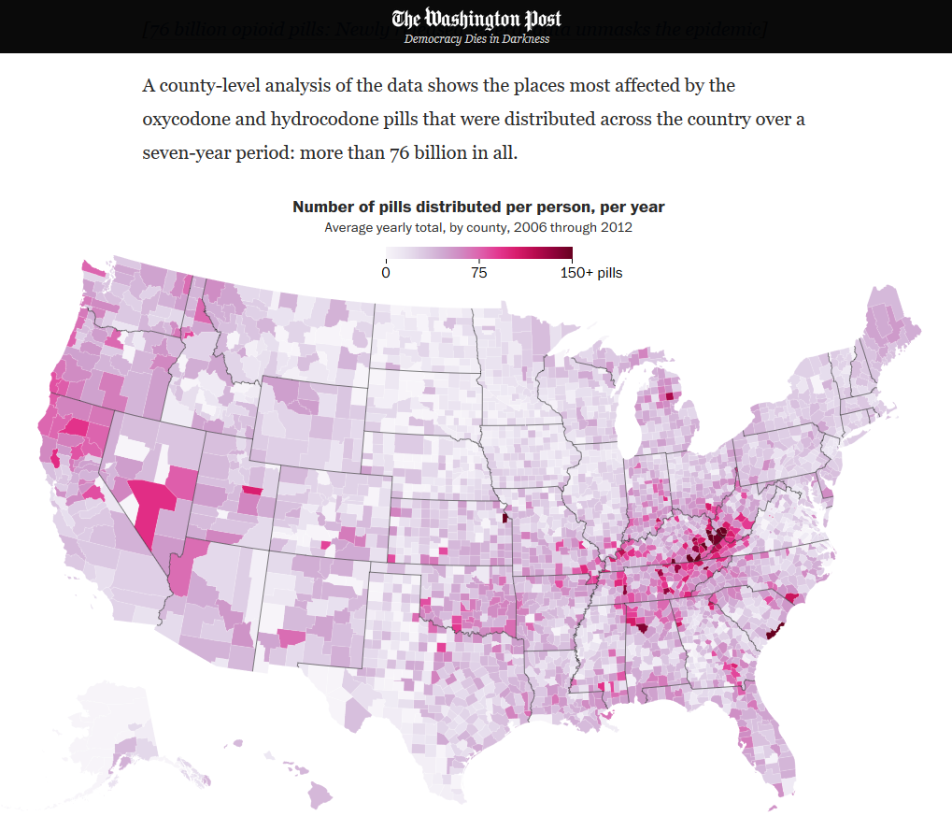
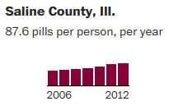
Source: https://www.washingtonpost.com/graphics/2019/investigations/dea-pain-pill-database/?utm_term=.d2b314afdfaa.

Slide 21
III. Measuring Opioid Misuse Economic Impacts

Slide 22
III. Measure Economic Impacts
Convergence of Factors:
  Declining overall Illinois population.
  Young adult population shrinking fastest.
  Rural affected more than urban areas.
  Shrinking population leads to shrinking labor force.
  Opioid misuse has been growing.
  High rates of opioid misuse among working age adults.
How can we measure the economic impacts?
  Specific focus on relationship between opioid prescriptions and labor productivity.

Slide 23
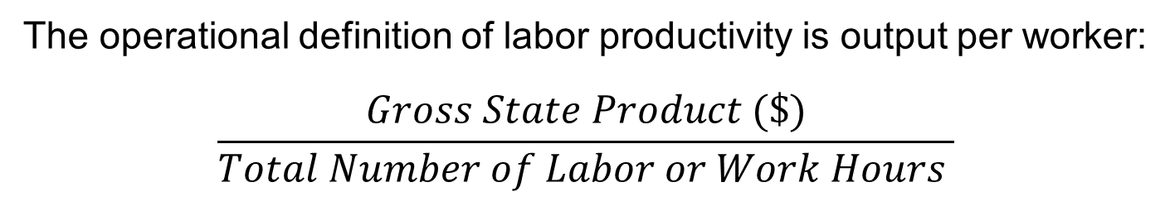
III. Labor Productivity and Opioid Impacts
The operational definition of labor productivity is output per worker:
$$\frac{Gross State Product (\$)}{Total Number of Labor or Work Hours }$$
Labor Productivity in Illinois
Year | Labor Productivity ($/hour) | Year | Labor Productivity ($/hour)
2007 | 58.3696 | 2013 | 68.7867
2008 | 58.7613 | 2014 | 71.0352
2009 | 61.7948 | 2015 | 73.1192
2010 | 63.5847 | 2016 | 74.4369
2011 | 65.2549 | 2017 | 75.3900
2012 | 67.9249 | ACGR | 2.56%

Slide 24
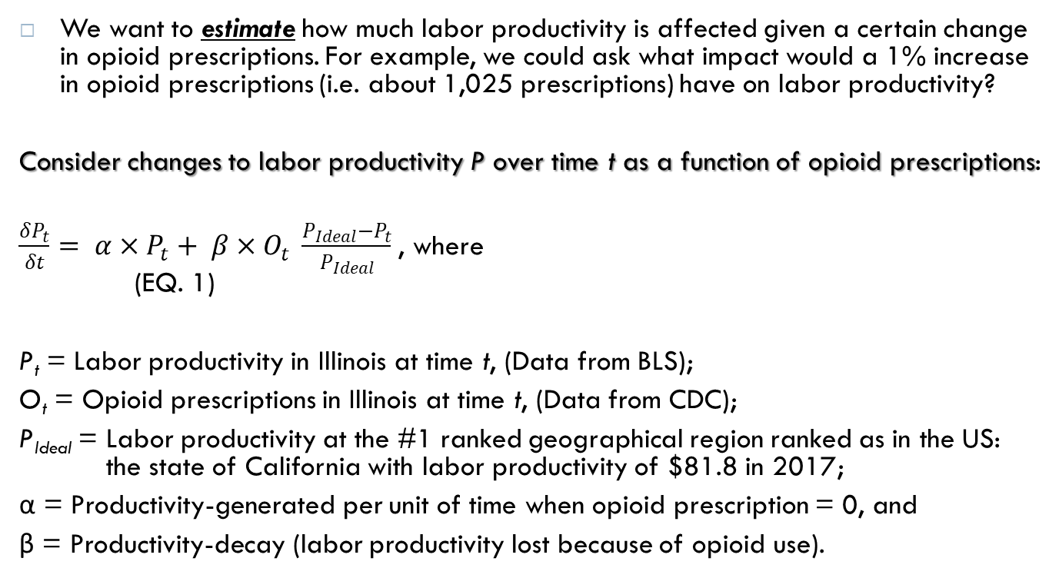
III. The Monetary Impacts of Opioid Misuse
We want to estimate how much labor productivity is affected given a certain change in opioid prescriptions. For example, we could ask what impact would a 1% increase in opioid prescriptions (i.e. about 1,025 prescriptions) have on labor productivity?
Consider changes to labor productivity P over time t as a function of opioid prescriptions:
$\frac{δP_{t}}{δt}= α×P_{t}+ β×O_{t} \frac{P_{Ideal}−P_{t}}{P_{Ideal}}$, where (EQ. 1)
P_{t} = Labor productivity in Illinois at time t, (Data from BLS);
O_{t} = Opioid prescriptions in Illinois at time t, (Data from CDC);
P_{Ideal} = Labor productivity at the #1 ranked geographical region ranked as in the US: the state of California with labor productivity of $81.8 in 2017;
α = Productivity-generated per unit of time when opioid prescription = 0, and
β = Productivity-decay (labor productivity lost because of opioid use).

Slide 25
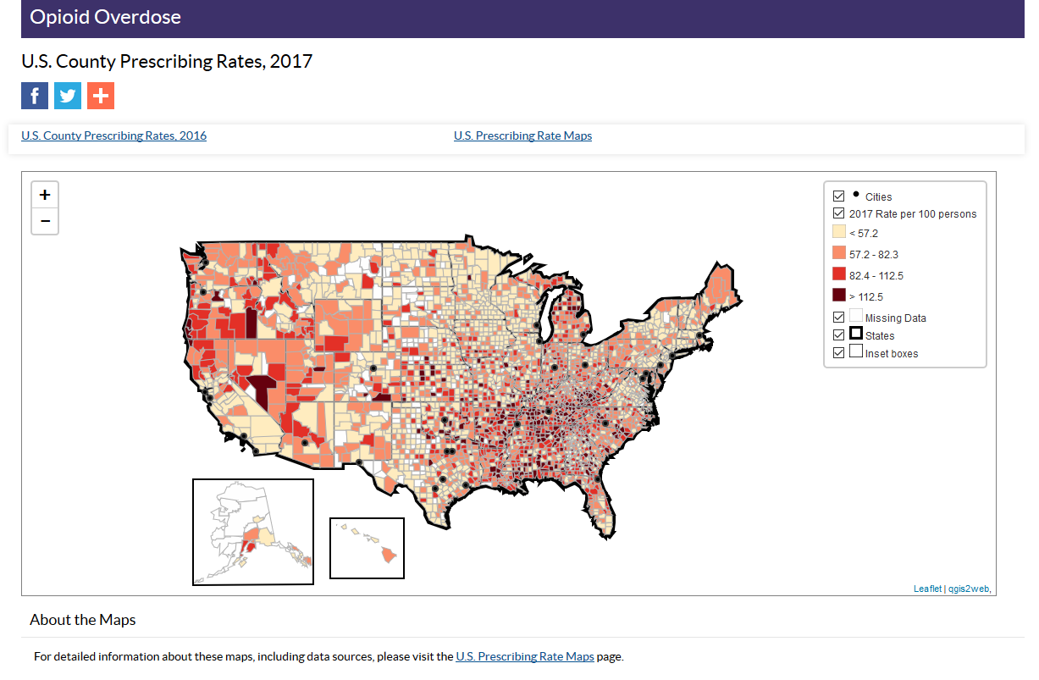
Source: https://www.cdc.gov/drugoverdose/maps/rxcounty2017.htm l

Slide 26
III. The Monetary Impacts of Opioid Misuse
For every 1% increase in prescriptions, from the base 2017 time period, labor productivity will decrease by $3.08 per hour from $75.39 to $72.31.
This translates into a 4% decline in the 2017 value of Illinois private non-farm production, from $686,221,000,000 to $658,168,000,000.
  One year productivity loss of $28,053,000,000.
However, there are economic impacts beyond losses to labor force productivity…

Slide 27
III. Beyond Labor Productivity Impacts
How might we estimate the economic value of opioid misuse overdose deaths?
  The costs of opioid-related overdose deaths rely on “value of a statistical life” concept. Federal agencies routinely rely on this concept to estimate the expected fatality risk-reduction benefits of a proposed regulation, or policy.
The central estimates used by three agencies, DOT, EPA, and HHS, range from a low of $9.4 million (HHS) to a high of $10.1 million value (EPA).
These estimates are used below to highlight the costs of opioid-related overdose deaths in Illinois during 2017.

Slide 28
III. Value of Statistical Life (that is lost)
Beyond the impact of labor productivity losses, we can calculate the monetary losses when a person dies from an opioid overdose. The value is based on lost earning potential.
Estimates suggest that opioid misuse deaths have cost the Illinois economy about $21 billion.

Slide 29
III. Other Non-Fatality Costs
In addition to the cost of fatalities each year, Florence et al. (2016) estimate that prescription opioid misuse results in an average cost of approximately$30,000 per person misusing opioids.
Costs factored into this calculation include additional:
  Health care costs;
  Substance abuse treatment costs;
  Criminal justice costs.
For Illinois, this amounts to:

Slide 30
IV. Conclusions
Lots of big numbers. Opioid misuse has enormous economic impacts.
Provided empirical evidence of the destructive effects of opioids on Illinois’ labor force.
  We estimate that a 1% increase in opioid prescriptions will cost the state 4% in GDP.
  Benham et al (2017) posit that opioid abusers miss twice as many days of work compared with other employees.
  According to Quest Diagnostics (2016), during 2011 to 2015, the positivity testing for heroin increased 146% for the US workforce.
Beyond, the painful public health and criminal justice impacts, opioid misuse has an enormous economic impact on each and everyone of us.
  Demographically stable rural communities need economic diversity.
    Manufacturing is an essential part of rural economic diversity.
    Opioid misuse has an enormous economic impact on manufacturing.
    One concern is that opioid misuse could accelerate rural depopulation as rural and downstate businesses struggle with the crisis.
  We welcome your suggestions for additional ways to measure the economic impacts of the opioid misuse crisis in Illinois.

Slide 31
Thank you.
Questions and Comments are Welcome!
Contact Information:
Chris Merrett, Ph.D., Director
Illinois Institute for Rural Affairs
Western Illinois University
Macomb, IL 61455
309-298-2281
cd-merrett@wiu.edu
http://www.iira.org

