Slide 2
NSC Mission
The National Safety Council eliminates preventable deaths at work, in homes and communities, and on the road through leadership, research, education and advocacy

Slide 3
Background
Notes:
Let everyone know you are going to cover the basics of opioids and substance use disorders to make sure everyone is on the same page

Slide 4
Phases of the Overdose Crisis
1990s
2013
2016
2010
1st Wave
Opioid prescribing (and overdoses) increase
2nd Wave
Rapid increase in overdose deaths that involve heroin – 286% from 2002 to 2013
3rd Wave
Increase in deaths from synthetic opioids (fentanyl)
4th Wave
Increase in overdose deaths with stimulants – up 42.4% since 2016
Opioid prescribing has been declining since 2012 – yet overdose rates have continued to climb
Notes:
SLIDE ANIMATION HERE
*19.2% reduction in all opioids prescribed between 2006 and 2017, with a 56.5% reduction in high dosage opioids [>90 MME]

Slide 5
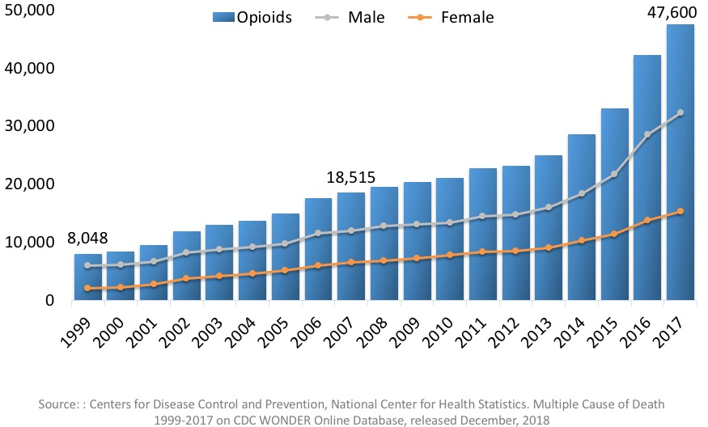
National Overdose Deaths from Opioids
Notes:
More than three out of five drug overdose deaths involve an opioid.
Opioid pain relievers and heroin contribute to more deaths than any other drug – around 130 people a day. This number has more than quadrupled since 1999.
Evidence shows that some people who misuse opioid medications migrate to heroin because heroin is accessible and less costly. In fact, nearly 80 percent of recent heroin initiates reported that they began their opioid use through the nonmedical use of prescription opioid medications

Slide 6
Notes:
Take aways from video:
Baby boomers were first effected in 1990s, then in 2007 millennials see spikes in overdose deaths. Now the age group with the largest number of opioid deaths occur among those that are 25-34.
Overdose deaths involving synthetic opioids (mostly fentanyl) increased by 921% from 2013.
Overall, this epidemic is constantly evolving and we have to evolve to create solutions that work.

Slide 7
About Opioids
Notes:
Let everyone know you are going to cover the basics of opioids and substance use disorders to make sure everyone is on the same page

Slide 8
Opioid Basics
Commonly prescribed opioid painkillers include Dilaudid, hydrocodone, morphine, oxycodone, and Percocet
Notes:
Opioid pain relievers are the most commonly prescribed for a variety of painful conditions, including dental and injury-related pain.
Illicit opioids include heroin, fentanyl (in illicit form it’s a powder), and others
They reduce the intensity of pain signals reaching the brain and affect those brain areas controlling emotion, which diminishes the effects of a painful stimulus.

Slide 9
Substance Use Disorders
The National Institute on Drug Abuse (NIDA) defines SUD as a long term, relapsing brain disease that is characterized by compulsive drug-seeking and use despite harmful consequences
20.8 million people in the US are living with a substance use disorder
Illinois – 12.74 million people (2018)
Notes:
Important to address what a SUD is before we can get into opioids specifically
SUDs can impair physical health, mental health and other functioning.
This disease is not caused by moral shortcomings or weakness of character, and it is not a choice that someone makes.
SUDs are treatable, and recovery is the expected outcome of treatment.
Substance use disorders don’t discriminate – people of all ages, genders, races, of any socioeconomic status, and living any geographic region can be affected. Data demonstrate this clearly:

Slide 10
Risk Factors for Developing an Opioid Use Disorder
Personal & Family History
Previous Treatment
Depression or Anxiety
Long Term Use
Notes:
As an employer, you cant control this but good to know– it’s a complex problem, look at protective factors such as prosocial involvement in work and employment as a whole
Personal or family history of addiction or substance misuse
While 84% of doctors screen for an individual history of addiction or misuse, only 32% of doctors are screening for a family history before prescribing opioid pain relievers
Past participation in previous treatment programs for alcoholism or addiction

Slide 11
Addressing the Opioid Crisis
Prevention
Treatment / recovery
Opioid overdose prevention
Societal components
Notes:
Reducing access, education / awareness, prescriber education, safe disposal
Increasing access / support, destigmatizing
Naloxone / other linking to care for people w/OUD
SES / employment / homelessness

Slide 12
Opioids + the Workplace
Notes:
Now we are going to talk about how opioids specifically impact the workplace.
The workplace is a key place to intervene because 95% of overdoses occur in working aged adults.

Slide 13
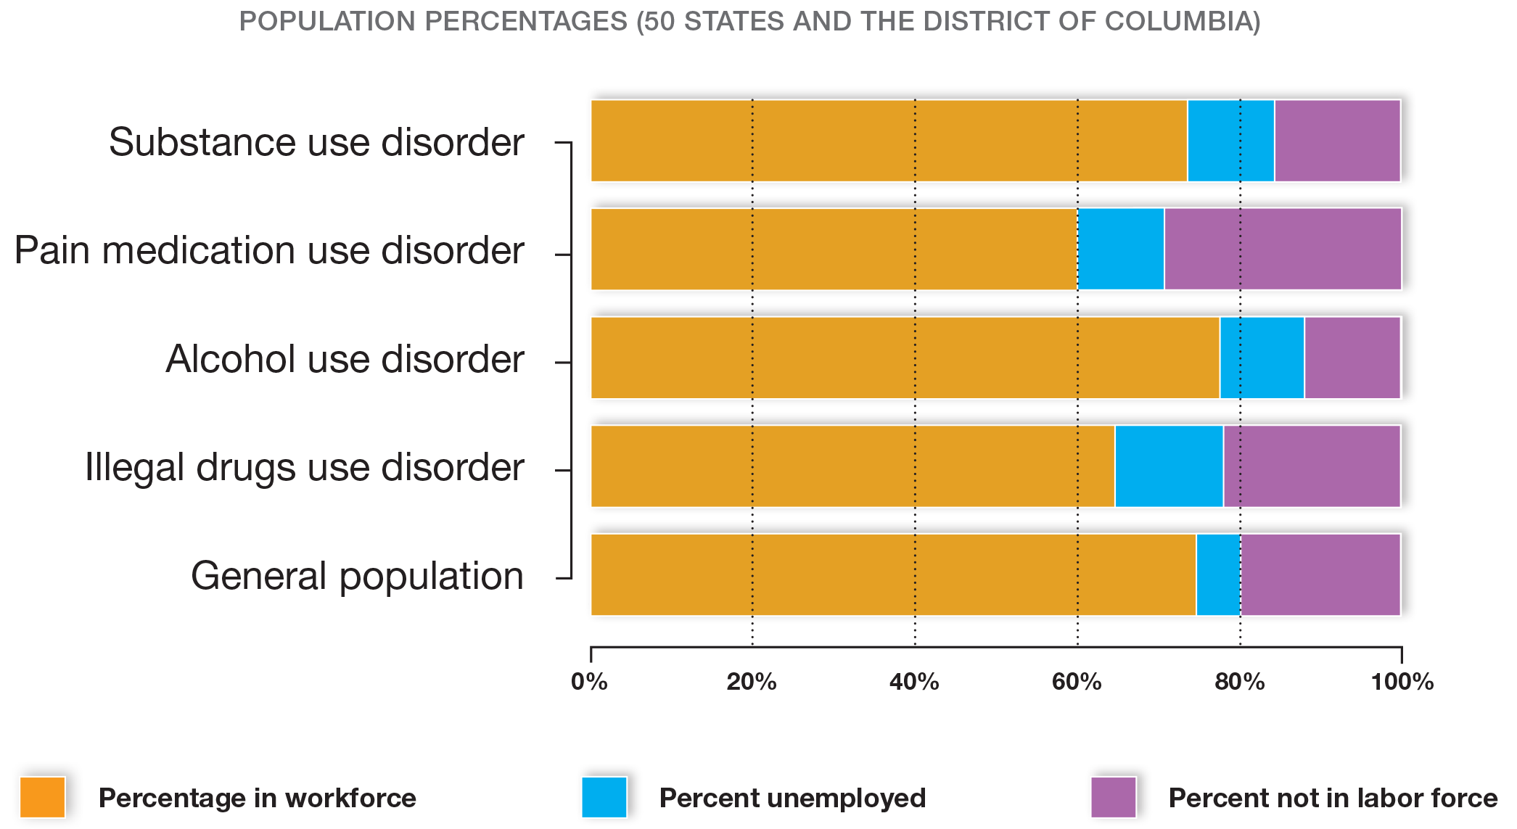
National Survey on Drug Use and Health
Notes:
Continue why we started in the opioid/employer space
Point out that the SUD population that employed looks to be around 77% in the graph
56% of off the job deaths – over 44K – are drug poisonings
(9/10 worker deaths / 7/10 injuries are off the job) – results in lost production time / bottom line / human impacts

Slide 14
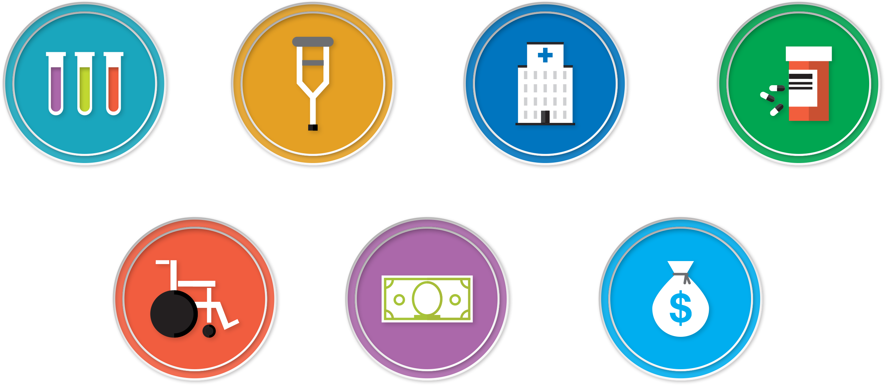
Effects on the Workplace
Screening
Injuries
Medical
Treatment
Disability
Insurance
Workers Comp
Notes:
Costs for screening and testing→ depends on each company's policy on this
Risk for incidents, injuries and errors→ These drugs can alter a person’s judgment, create tremors, reduce muscle strength, impair coordination and even create confusion.
Emergency room visits and other medical care→ employees with an opioid use disorder spend five times as many days in the hospital each year
Length of disability→ disability lasts longer when on opioids
Workers compensation costs→ if someone is misusing, they are more likely to get injured on the job, and consequently cost the company money in workers comp

Slide 15
Common Workplace Risks
Driving
Operating Equipment
Critical Errors
Productivity
Notes:
Driving vehicles to/from/at work
Operating machinery/equipment
Making critical errors
Lessoning productivity (pace, focus and concentration)
There is a higher percentage of turnover with employees who have an opioid use disorder. Only 58% have had the same employer from the previous year compared to 75% of the general population
This can occur if a loved one has a substance use disorder [IE – parents working 2nd shift, high school age daughter who is struggling, 6 hours without supervision, means parents aren’t focused at work]

Slide 16
Prevention in the Workplace
Employee education
Workplace policy
Workplace culture
Benefits and healthcare plans
Notes:
Connect all of the risks and the workplace and the effects on the workplace to the need for treatment and recovery programs to segue
MAT→ methadone, naltrexone, buprenorphine
Traditional inpatient treatment programs that consist of detoxification or medically managed withdrawal followed by an abstinence based treatment program are less effective for opioid and heroin use disorders and may increase the risk of a fatal overdose.
For implementation –
Talk with EAP to figure out what actually happens when an employee engages on this subject [confidentiality, types of referrals]
Med insurance to ensure access to / coverage of MAT
Work with local groups to know what social support mechanisms are out there
Know what to expect from different forms of MAT – use your MRO(A) or other medical resources for guidance
Do NOT prioritize one type of treatment over another in terms of coverage / return to work policies need to be clear about what’s mandated
Keeping an employee out of work for the duration of treatment could have a myriad of unanticipated consequences, including but not limited to people stopping their treatment (MAT or otherwise) earlier than medically appropriate to return to work earlier, leading to increased risk for relapse.

Slide 17
Treatment and Recovery in the Workplace
Addiction can be treated and patients do recover
More than 10% of Americans live in recovery
The most effective treatment for OUD is a combination of medicine, behavioral health services, and recovery support
Notes:
Connect all of the risks and the workplace and the effects on the workplace to the need for treatment and recovery programs to segue
MAT→ methadone, naltrexone, buprenorphine
Traditional inpatient treatment programs that consist of detoxification or medically managed withdrawal followed by an abstinence based treatment program are less effective for opioid and heroin use disorders and may increase the risk of a fatal overdose.
For implementation –
Talk with EAP to figure out what actually happens when an employee engages on this subject [confidentiality, types of referrals]
Med insurance to ensure access to / coverage of MAT
Work with local groups to know what social support mechanisms are out there
Know what to expect from different forms of MAT – use your MRO(A) or other medical resources for guidance
Do NOT prioritize one type of treatment over another in terms of coverage / return to work policies need to be clear about what’s mandated
Keeping an employee out of work for the duration of treatment could have a myriad of unanticipated consequences, including but not limited to people stopping their treatment (MAT or otherwise) earlier than medically appropriate to return to work earlier, leading to increased risk for relapse.

Slide 18
Workers in Recovery Succeed
Source: National Survey on Drug Use and Health, comparison of 2012-2013 and 2013-2014 data
Notes:
Over 90% of people with a prescription drug use disorder recover→ point out in the chart that those in recovery have lower numbers than the general workforce in every category
Alcohol and marijuana have the highest rates of use and misuse, but studies show that there is a positive relationship between employment and recovery across type of substance used, including alcohol, marijuana, cocaine, opioids, and polysubstance use
When developing workplace policy, remember that relapse is a normal part of the process. Most people are not able to stop using drugs forever the first time they try to quit. Though achieving and sustaining recovery may take an unpredictable path, supporting employees as they seek treatment and recovery is well worth it. Employees in recovery miss less time at work, take fewer sick days, and change jobs less frequently than the general workforce.
By supporting employees in recovery, employers will also create strong reasons for job satisfaction and loyalty in their workforce.

Slide 19
Recovery Friendly Workplaces
Recognize recovery as a strength, and intentionally embracing and hiring people in recovery
Openly discuss addiction and connects employees to local resources
Safe, healthy, and supportive space for employers and employees in recovery, and employers and employees who aren’t in recovery.
Notes:
Recovery friendly workplaces prevent feelings of stigma and isolation, and greatly improves employee’s chances of recovery. A supportive workplace environment can also help prevent relapse.
“People can and do recover. Recovery from substance use disorders has had several definitions. Although specific elements of these definitions differ, all agree that recovery goes beyond the remission of symptoms to include a positive change in the whole person. In this regard, “abstinence,” though often necessary, is not always sufficient to define recovery. There are many paths to recovery. People will choose their pathway based on their cultural values, their psychological and behavioral needs, and the nature of their substance use disorder.” – Jerome Adams, US Surgeon General

Slide 20
NSC Workplace Efforts
Notes:
The workplace is NSC’s bread and butter and that we’ve been doing this for more than 100 years- i.e. trust what we have to say
We have 15,000 members

Slide 21
Opioids At Work: Employer Survey
Completed in January 2019, with 526 survey responses across a geographically representative sample of US employers – included a variety of industry types and organization sizes
HR Decision Makers
Safety Professionals
Managers
Goal: assess impact of the overdose crisis and attitudes towards the opioid crisis in a diverse group of employers
Notes:
The National Safety Council (NSC) commissioned B2B International to conduct a survey with employers about their awareness of opioids-related issues, the impact of opioids on their organizations, and their processes and policies for dealing with it. The findings provide a robust picture of how employers are reacting to the opioid epidemic, and the support they are looking for organizations like NSC to provide them with.
1. HR Decision Makers: Professionals who are involved in formulating employee / human resources policies affecting the recruitment, retention and well-being of the workforce.
2. Safety Professionals: Mid/senior management level safety professionals, involved in workplace policies and initiatives surrounding risk management and safety protocols, inspection, training and/or monitoring.
3. Managers: Mid / senior management level decision makers who may not be directly involved in HR or safety policy, but oversee, approve or sign-off initiatives, investments, training and workplace priorities.
We contracted with an agency to reach these audiences (B2B)
The next set of survey results will be (hopefully) released in April 2019
This survey is based on a geographically representative sample of US businesses, with a good mix of industries and company sizes. All represent organizations with 50 or more employees, and all are based in the US. While 23% of the businesses are global, all responses are focused on US operations.
Main focus of the questions and why we did this?
Focused on what employers are currently doing and current beliefs surrounding substance misuse in their workplace
We did this to further inform our interventions and help others to do this as well

Slide 22
Take Aways
Need a team approach
Employers are interested in prevention, approaches differ
Employers are uncertain how to address treatment and recovery in the workplace – barriers exist
Notes:
Team comments
Pill limits / education / alt pain mgmt coverage
Co pays, lack of options, unsure what works, not sure how to handle lapsing nature of SUDs

Slide 23
What Can We Do?

Slide 24
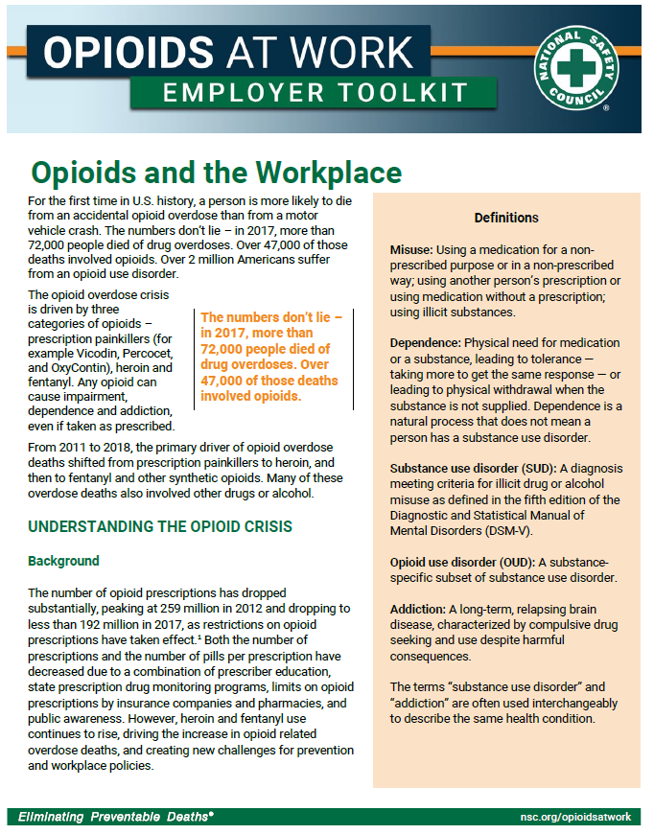
Opioids At Work: Employer Toolkit
The Opioids At Work Employer Toolkit is a free resource NSC developed to take employers step by step as they navigate through the opioid crisis.
The full version of the Employer Toolkit is due to be released in September 2019.
Notes:
The following recommendations and topics in the rest of the presentation can all be found within this toolkit which is FREE.
Contents include but are not limited to:
Educational materials for employers and employees
Specific suites of documents targeted at HR professionals, EHS professionals, and manager and supervisors
5 minute safety talks
Medication safety and disposal
Sample policies
Employee opioid communication plan
Legal considerations

Slide 25
Employers can play a unique role in the opioid crisis by taking these actions
Engaging and educating employees
Training managers and supervisors on the role they can play
Encouraging Human Resources to create compassionate, comprehensive policies
Obtaining senior leadership engagement and support
Notes:
These recommendations outline the rest of the presentation in the above order

Slide 26
Updating employer health care plans and pharmacy benefit programs
Creating a safe, hazard free workplace
Developing a workplace culture of health and wellness to reduces stigma and support recovery
Employers can play a unique role in the opioid crisis by taking these actions
Avoiding generic policies – learn about and address unique workplace needs
Notes:
Do not feel overwhelmed by these, just making one of these changes (or a piece of one) can make a huge difference.

Slide 27
Take Action
Employer guide
5-minute safety talks
Employee education resources
Sample policies
Download at NSC.org/opioidsatwork

Slide 28
Rachael Cooper
rachael.cooper@nsc.org
630.373.7981
NSC.org/opioidsatwork

