Slide 1
It’s Everyone’s Issue
Opioid Substance Misuse Conference
Rosie Gianforte, LCSW Statewide Opioid Resource Director
Illinois Department of Human Services
Division of Substance Use Prevention and Recovery (SUPR)
Rosie.m.Gianforte@illinois.gov
Thursday, July 19th, 2019

Slide 2
This workshop:
The opioid/substance misuse crisis has been evolving for some time.
From pain relief and prescribing patterns, to lack of public/patient awareness and high potency synthetics - understanding the framework helps people understand how and where they can use their leverage to address this crisis.

Slide 3
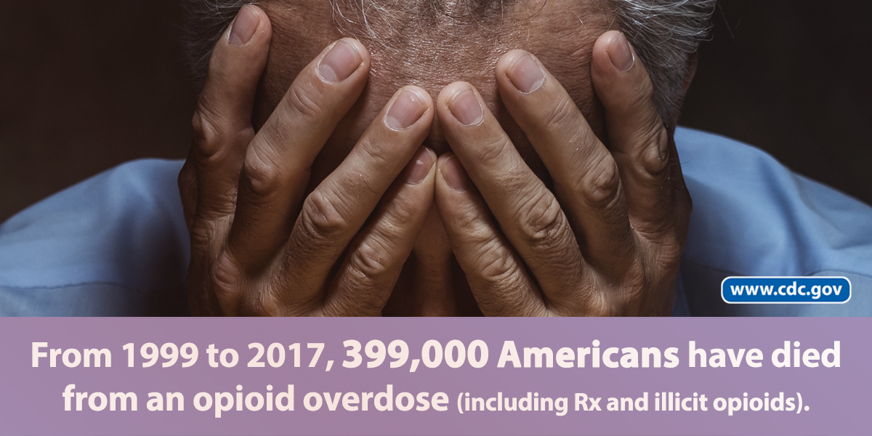
National opioid epidemic

Slide 4
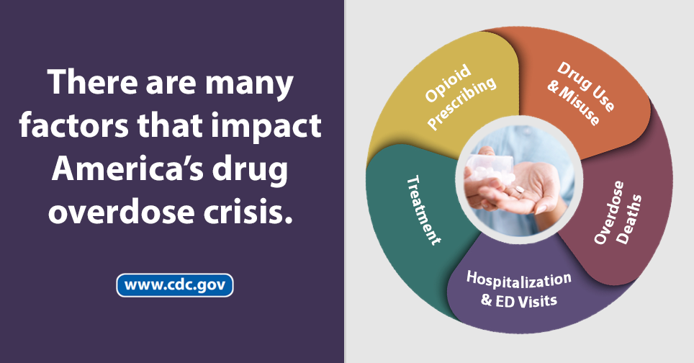
Why is this happening?
Notes:
Wilson M. Compton, M.D., M.P.E., Christopher M. Jones, Pharm.D., M.P.H., and Grant T. Baldwin, Ph.D., M.P.H., (2016). Relationship between Nonmedical Prescription-Opioid Use and Heroin Use. The New England Journal of Medicine
In the context of marked increases in the rates of heroin use, it is important to note that only a small percentage of nonmedical users of prescription opioids initiate heroin use. Muhuri and colleagues found that 3.6% of nonmedical users initiated heroin use within 5 years after beginning nonmedical use of prescription opioids. Jones et al. found that approximately 4.2% of persons who had used prescription opioids non-medically during the previous year in the period of 2011–2013 also reported using heroin during the previous year. Of note, given the large number of nonmedical users, even a small percentage who initiate heroin use translates into several hundred thousand new heroin users. Yet, taken in total, the available data suggest that nonmedical prescription-opioid use is neither necessary nor sufficient for the initiation of heroin use and that other factors are contributing to the increase in the rate of heroin use and related mortality.
Multiple studies that have examined why some persons who abuse prescription opioids initiate heroin use indicate that the cost and availability of heroin were primary factors in this process. This points to a common factor that prevention has been addressing – Access.
The variety of risk factors that place individuals and communities at risk will need a variety of prevention strategies focused on protective factors.
No one specific cause
Many risk factors
Context – economically depressed communities
Adverse Childhood Experiences
Mental health symptoms
Substance use
Pain as a vital sign
Marketing

Slide 5
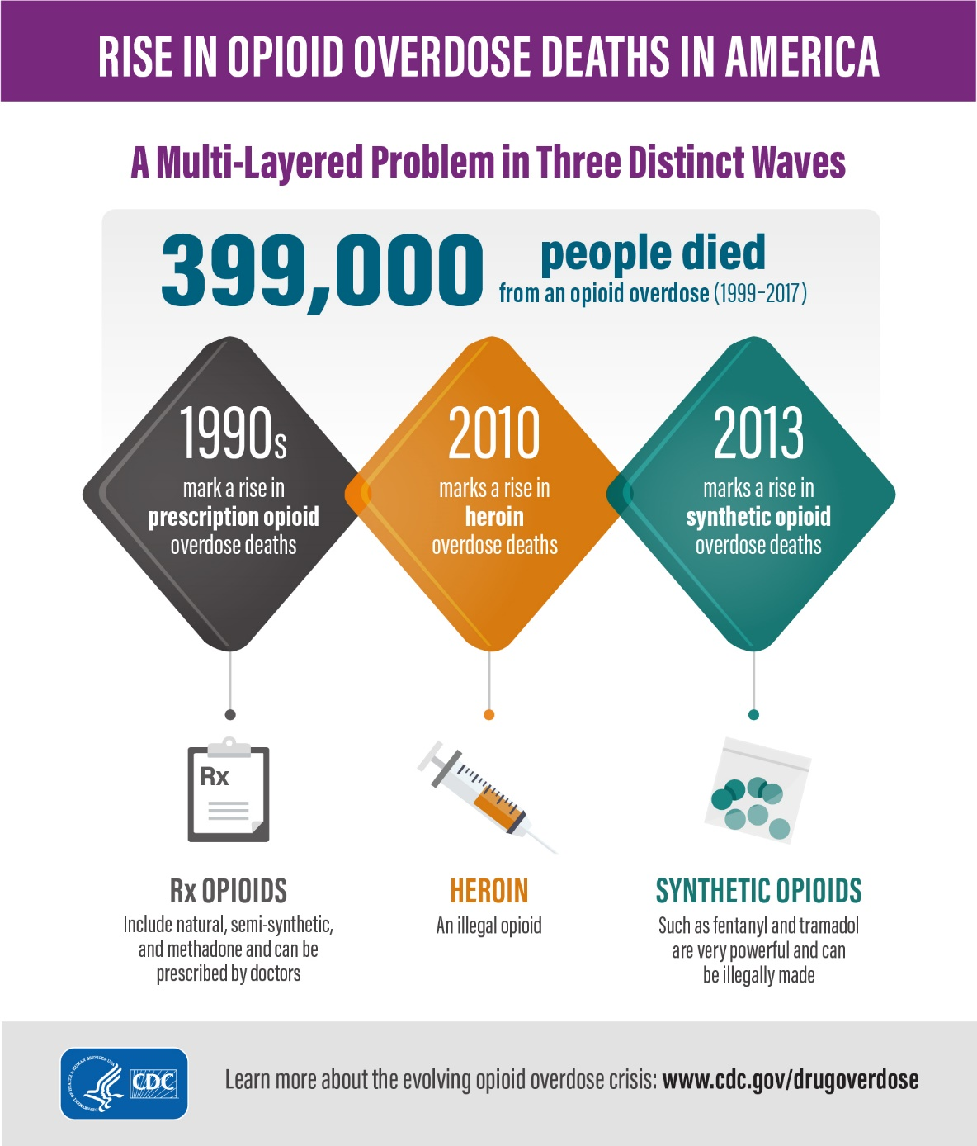
Historical Perspective
Notes:
Drug overdose deaths can be hard to categorize. An average of 22,000 deaths per year… Yet, in 2017
In 12% of drug overdose deaths in 2017, no specific drug was listed on the death certificate. In many deaths, multiple drugs are present, and it is difficult to identify which drug or drugs caused the death (for example, heroin or a prescription opioid, when both are present).

Slide 6
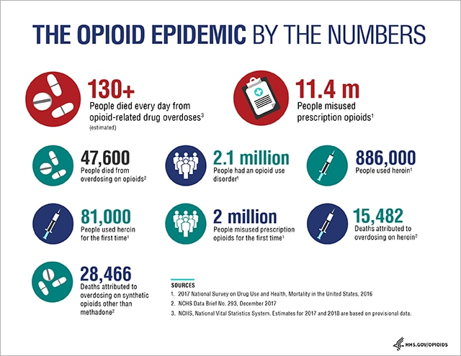
What is the U.S. Opioid Epidemic – 2017 Statistics
Notes:
What is the U.S. Opioid Epidemic?
In the late 1990s, pharmaceutical companies reassured the medical community that patients would not become addicted to opioid pain relievers and healthcare providers began to prescribe them at greater rates.
Increased prescription of opioid medications led to widespread misuse of both prescription and non-prescription opioids before it became clear that these medications could indeed be highly addictive.
Opioid overdoses accounted for more than 42,000 deaths in 2016, more than any previous year on record. An estimated 40% of opioid overdose deaths involved a prescription opioid. Yet in 2017, 47,600 deaths were attributed to an opioid overdose.
In 2017 HHS declared a public health emergency and announced a 5-Point Strategy To Combat the Opioid Crisis

Slide 7
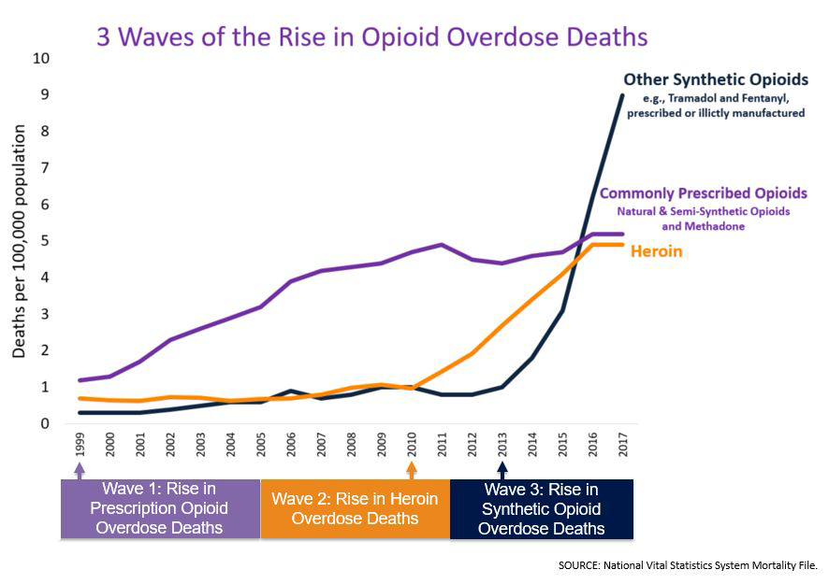
Notes:
From 1999-2017, almost 400,000 people died from an overdose involving any opioid, including prescription and illicit opioids.²
This rise in opioid overdose deaths can be outlined in three distinct waves.
The first wave began with increased prescribing of opioids in the 1990s ³, with overdose deaths involving prescription opioids (natural and semi-synthetic opioids and methadone) increasing since at least 1999.
The second wave began in 2010, with rapid increases in overdose deaths involving heroin.
The third wave began in 2013, with significant increases in overdose deaths involving synthetic opioids – particularly those involving illicitly-manufactured fentanyl (IMF). The IMF market continues to change, and IMF can be found in combination with heroin, counterfeit pills, and cocaine.

Slide 8
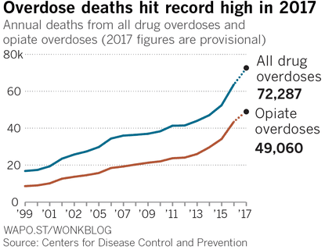

Slide 9
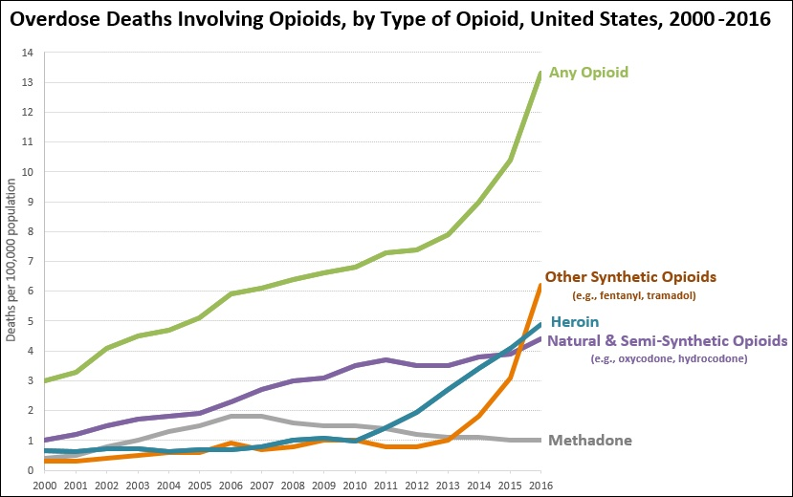

Slide 10
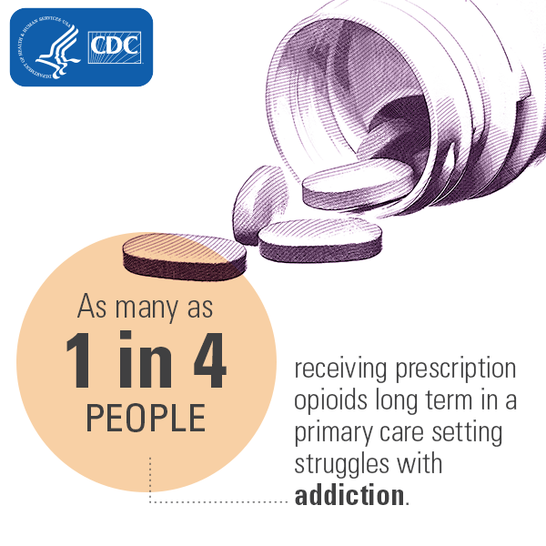
Substance Use Disorder

Slide 11
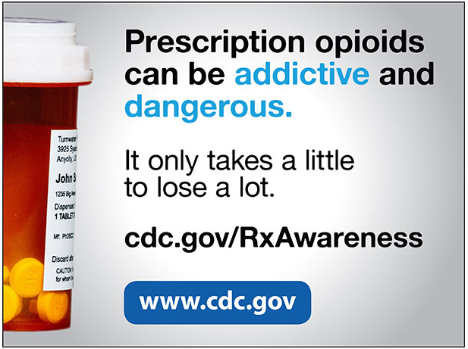
Notes:
Patients face an increased risk of opioid dependency in as few as four days of taking the drugs.

Slide 12
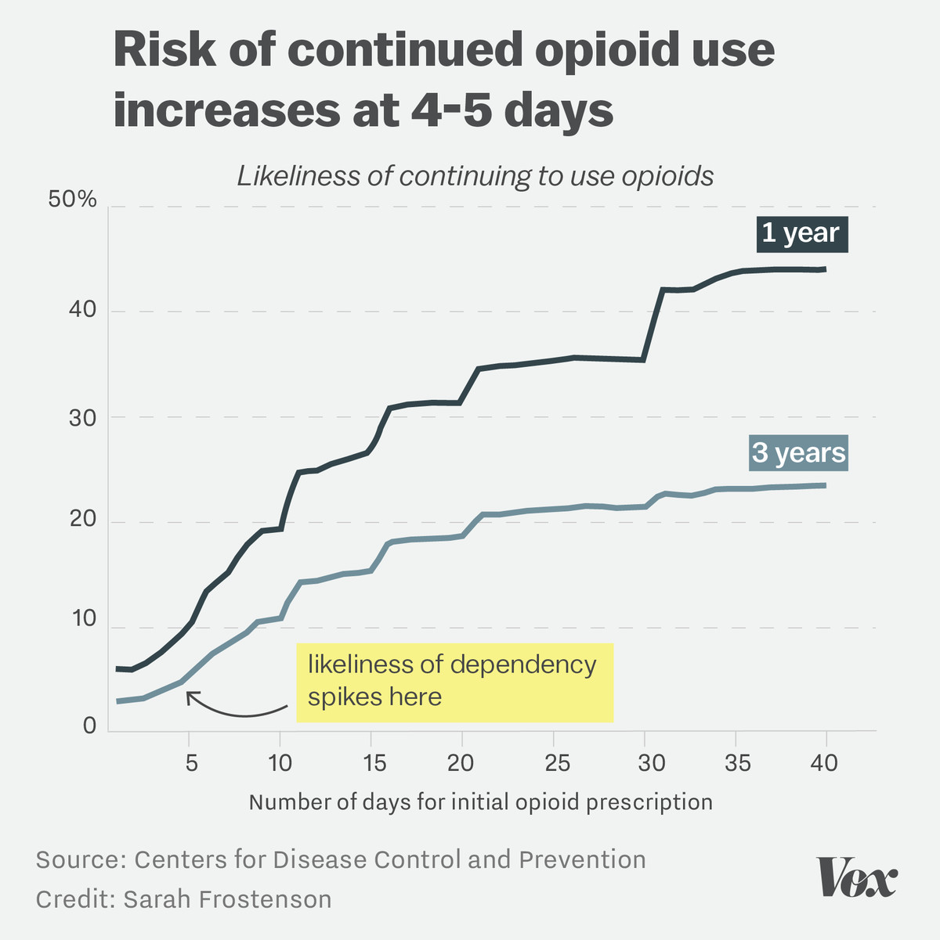
Notes:
As you can see in the chart, opioid prescriptions longer than five days in length significantly increased the likelihood of continued opioid use both one and three years later
"[For people who] take an opioid for 10 days, almost one in five will still be taking opioids one year later,"

Slide 13
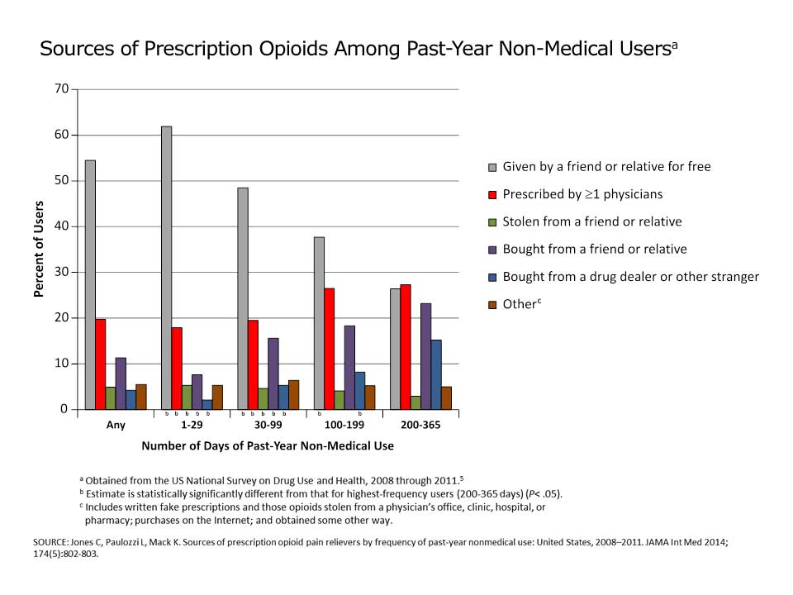

Slide 14
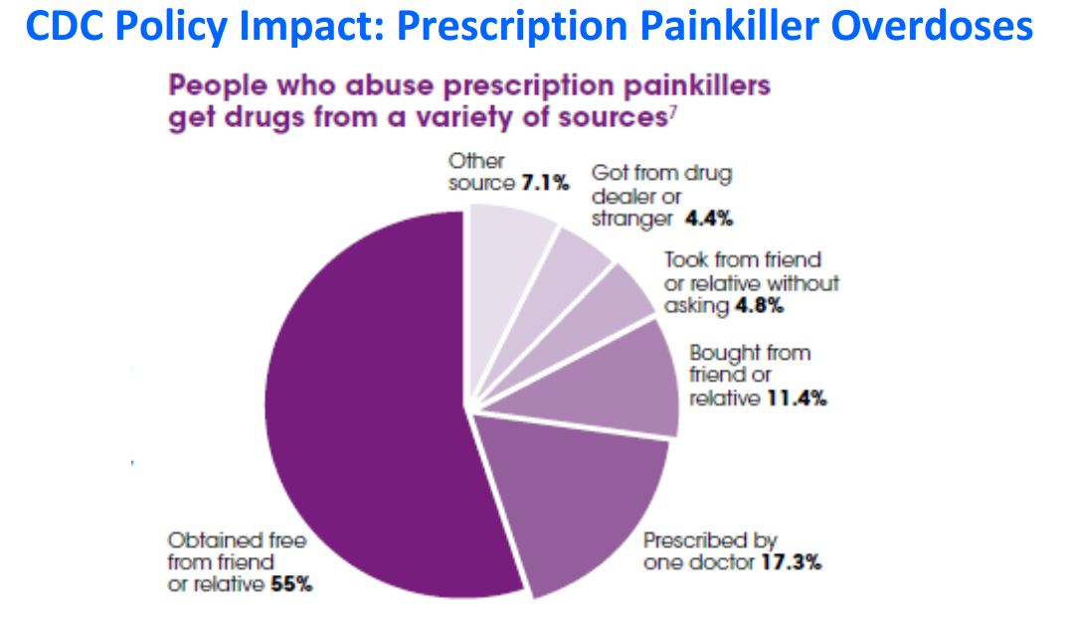

Slide 15
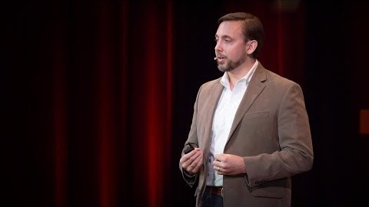
Travis’s Story
Notes:
https://www.bing.com/videos/search?q=travis+story+tapering+off+opioids&ru=%2fsearch%3fq%3dtravis%2520story%2520tapering%2520off%2520opioids%26form%3dSWAUA2&view=detail&mid=E7B788A1B199DC7F4AD1E7B788A1B199DC7F4AD1&&mmscn=vwrc&FORM=VDRVRV

Slide 16
Reasons for Increased Opioid Prescribing
Source: http://www.icjia.state.il.us/articles/opioid-prescribing-in-illinois-examining-prescription-drug-monitoring-program-data
Notes:
1. The belief that pain was undertreated and opioids carried low risk of addiction contributed to the medical community embracing increased opioid prescribing for pain conditions. This belief was not based on rigorous empirical evidence and there was an exaggeration of the potential benefits of long-term opioid treatment.
Patient satisfaction based in part on federally-mandated patient satisfaction surveys asking patients to rate hospital staff on their efforts toward pain management.
Drug companies’ aggressive tactics for selling opioid medications and the introduction in 1995 of OxyContin (a long-acting formulation of oxycodone) and subsequent unethical marketing practices employed by Purdue Pharma.
Unethical medical practice models, in some states sometimes referred to as “pill mills”, where patients could pay out of pocket to receive prescriptions for large volumes of opioids with minimal to
2. Patient satisfaction based in part on federally-mandated patient satisfaction surveys asking patients to rate hospital staff on their efforts toward pain management.
3. Drug companies’ aggressive tactics for selling opioid medications and the introduction in 1995 of OxyContin (a long-acting formulation of oxycodone) and subsequent unethical marketing practices employed by Purdue Pharma.
4. Unethical medical practice models, in some states sometimes referred to as “pill mills”, where patients could pay out of pocket to receive prescriptions for large volumes of opioids with minimal to no medical history or examination.

Slide 17
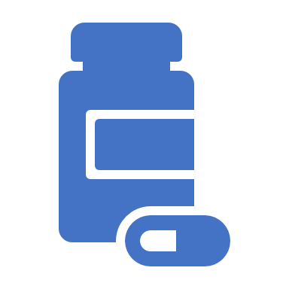
Prescription Drug Monitoring Programs
PDMPs collect, monitor, and analyze electronically transmitted prescribing and dispensing data submitted by pharmacies and dispensing practitioners.
The data are used to support states' efforts in education, research, enforcement and abuse prevention.

Slide 18
Illinois’ Opioid Crisis

Slide 19
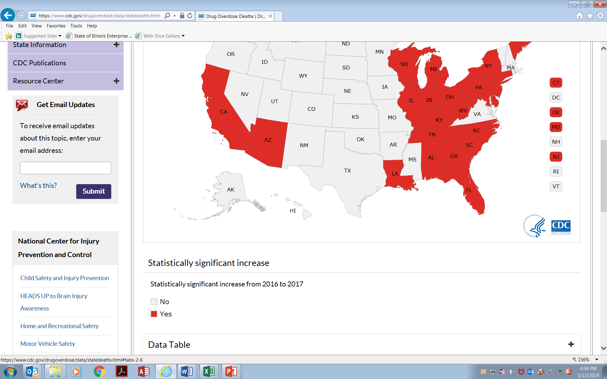
Illinois’ Opioid Crisis
Overdose Deaths

Slide 20
In Illinois
2016 Data
Source: Illinois Department of Public Health

Slide 21
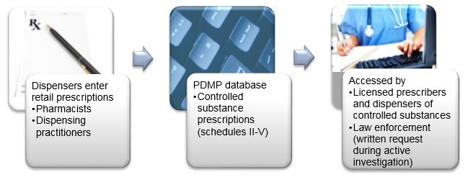
FLOW OF DATA OF ILLINOIS PRESCRIPTION MONITORING PROGRAM
Notes:
Operated by the Illinois Department of Human Services. Data is entered daily by pharmacies and dispensing practitioners for all controlled substances scheduled as II to V.
The program’s mission is to enhance a prescriber’s and dispenser’s capacity to review a patient’s prescription history to assist in the effective treatment of patients.
^{[28]} A new law effective January 1, 2018, requires most licensed controlled substance prescribers to register with and attempt to access patient information in the ILPMP when providing an initial opioid prescription for Schedule II narcotics such as opioids [Public Act 100-0564].

Slide 22
FEDERAL SCHEDULES OF OPIOID MEDICATIONS REPORTED IN ILPMP
Schedule | Drug Names
Schedule II | Codeine Fetanyl- Ublimaze® Hydrocodone- Vicodin®, Lortab®, Lortab ASA®, Hycomine®, Vicoprofen® Hydromorphone–Dilaudid® Meperidine- Demerol® Methadone Morphine- MSContin® Opium- Opium tincture (laudanum) Oxycodone- OxyContin®, Percocet®, Percodan® Oxymorphone- Numorphan® Tapentodol
Schedule III | Codine (mixed with aspirin or acetaminophen)-Tylenol #3® Buprenorphine- Buprenex® Buprenorphine/naloxone- Suboxone®, Subutex®Morphine (some combination products)
Schedule IV | Butorphanol- Stadol® Dihydrocodeine Pentazocine- Talwin injectable Propoxyphene- Darvon®, Darvocet®Tramadol
Schedule V | Codeine cough suppressant Hydrocodone cough suppressant
Prescribed with refills
Source: ILPMP data showing the top 20 most commonly prescribed opioids.
Notes:
Note: Schedule I opioid drug is heroin and not available by prescription; Schedule II drugs are not able to be prescribed with refills but can be obtained with a new prescription; Schedule III-V are available to be prescribed with refills.
Note: Methadone is approved by the U.S. Food and Drug Administration for treatment of pain when written as a prescription. It can be dispensed from federally monitored programs for the treatment of opioid use disorder. When dispensed from those programs, is not captured in the ILPMP. Buprenorphine comes in a variety of formulations and some are approved for pain (i.e. butrans patch). Others are approved for treatment of opioid use disorder (i.e. Suboxone and Subutex).

Slide 23
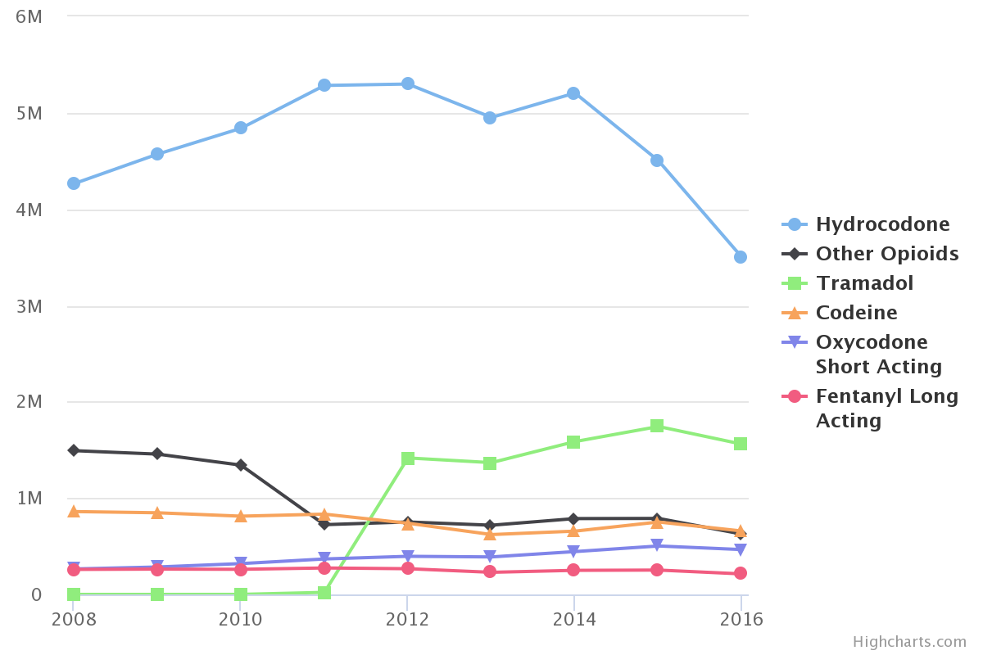
NUMBER OF OPIOID PRESCRIPTIONS FILLED IN ILLINOIS BY DRUG TYPE, 2008-2016
Notes:
Over the nine year period examined, hydrocodone accounted for about 60 percent of all opioids prescribed in Illinois. Hydrocodone is available in multiple generic and brand name drug versions, including Lortab, Norco, and Vicodin.
In Illinois, Schedule III, IV, and V prescriptions are allowed to be written with refills, but Schedule II are not. The hydrocodone prescription reduction in Illinois after the rescheduling was consistent with national trends.

Slide 24
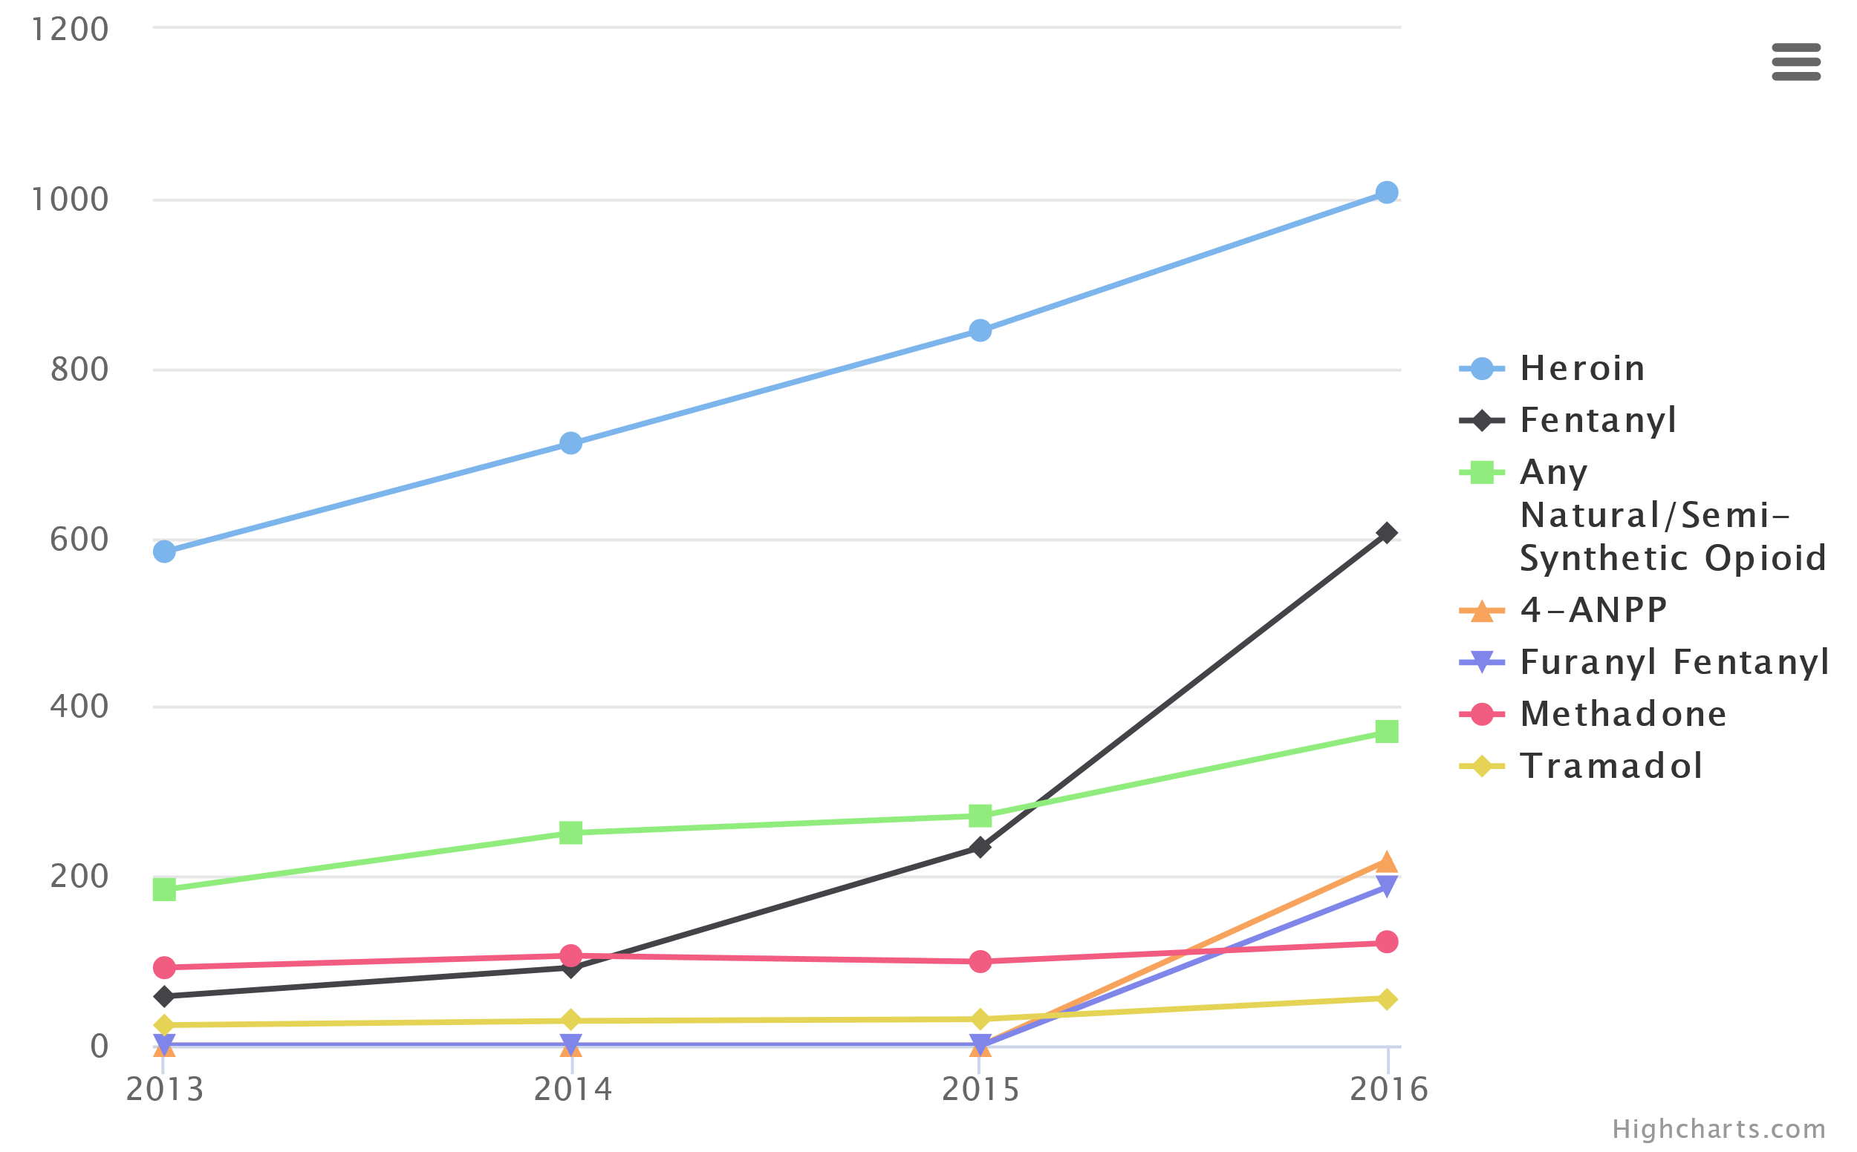
ILLINOIS DRUG OVERDOSE DEATHS BY DRUG TYPE, 2013-2016
Notes:
Heroin and illicit fentanyl-related overdoses are increasing in Illinois and available data suggest fentanyl overdoses are from illicit markets rather than prescriptions.
^{[54]} Despite modest reductions in prescription rates, the state’s criminal justice, public health, and human services departments should continue to work on prescription drug safety and reducing opioid overprescribing, especially considering that most people who misuse opioids report obtaining them from friends and family for free.
^{[55]} To tackle issues related to prescribing and the opioid crisis, the State of Illinois Opioid Action Plan recommends increased use of the ILPMP by providers in conjunction with provider education and promotion of prescribing guidelines, such as the CDC’s guidelines for prescribing opioids for chronic pain.

Slide 25
Who is at risk of overdose?

Slide 26
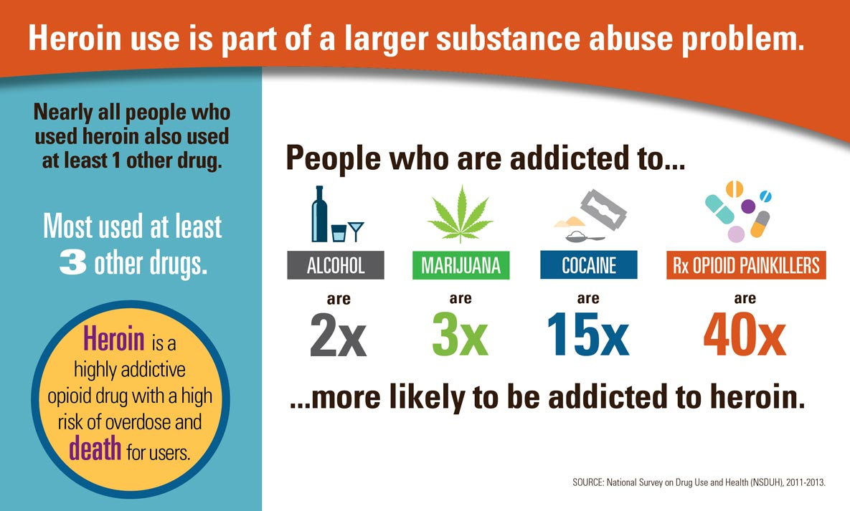
Notes:
Heroin and Fentanyl deaths are now more common than deaths from prescription drugs like Oxycodone
Heroin and Fentanyl, however, are cheaper and easier to get (especially with new opiate regulations). So once a person is addicted, they switch to these. 4/5 people who use heroin report using prescription meds prior to heroin use.
94% of people who use heroin said prescription meds were too expensive and too hard to get.
Then people die because Heroin and Fentanyl are way stronger than oxycodone (and often cut).
Thus, one would expect Heroin and Fentanyl deaths to eclipse deaths from legal (and far more expensive, especially given demand) painkillers.

Slide 27
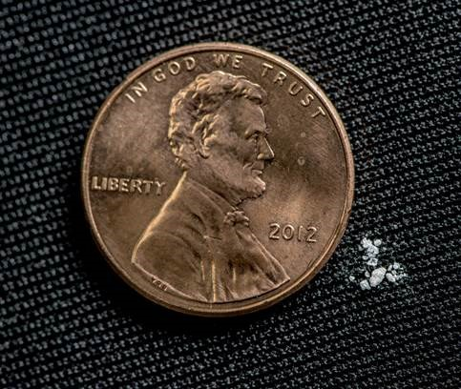
Fentanyl Deadly Dose
Notes:
the data suggest the vast majority of fentanyl overdoses are due to illicitly manufactured fentanyl rather than fentanyl originating from a prescription/pharmacy.
Fentanyl drove drug overdose deaths to a record high in 2017 — about 200 a day — CDC estimates
fentanyl, a synthetic opioid that’s roughly 50 times more potent than heroin. Because it’s cheap and relatively easy to make, it’s often mixed with other drugs like heroin and cocaine.

Slide 28

Illinois Opioid-Involved Overdose Deaths 2014 - 2017
Deaths | 2014 | 2017
Fentanyl | 127 | 1,187
Heroin | 844 | 1,251
Prescription | 343 | 623
Notes:
The greatest increase in opioid deaths was seen in cases involving synthetic opioids (mainly fentanyl):
a rise from 127 deaths in 2014 to 1,187 deaths in 2017 (Figure 1).
Deaths involving heroin also increased significantly in the same 3-year period: from 844 to 1,251 deaths.
There were 623 deaths involving prescription opioids in 2017, nearly double the 343 deaths in 2014.

Slide 29
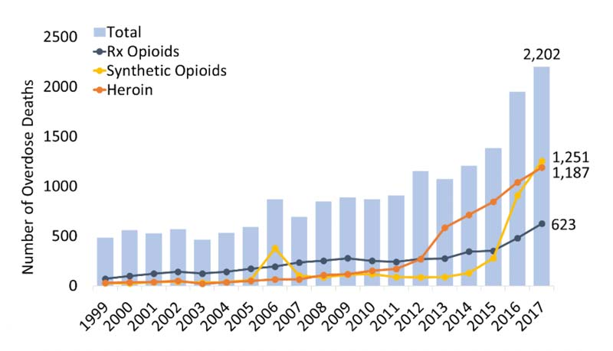
Illinois Opioid-Involved Overdose Deaths 1999 - 2017
Notes:
In 2017, there were 2,202 drug overdose deaths involving opioids in Illinois—a rate of 17.2 deaths per 100,000 persons, which is higher than the national rate of 14.6 deaths per 100,000 persons.

Slide 30
Illinois Dept. Public Health EMS Overdose Data
Fatal Overdose 2015 - 2018
Non-fatal Overdose 2015 - 2018
Notes:
In 2017, there were 2,202 drug overdose deaths involving opioids in Illinois—a rate of 17.2 deaths per 100,000 persons, which is higher than the national rate of 14.6 deaths per 100,000 persons.

Slide 31
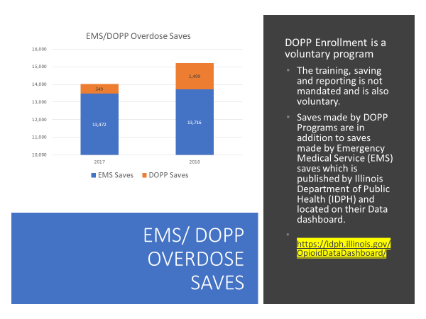

Slide 32
Illinois Department of Public Health
IDPH Data Dashboard
https://idph.illinois.gov/OpioidDataDashboard/

Slide 33
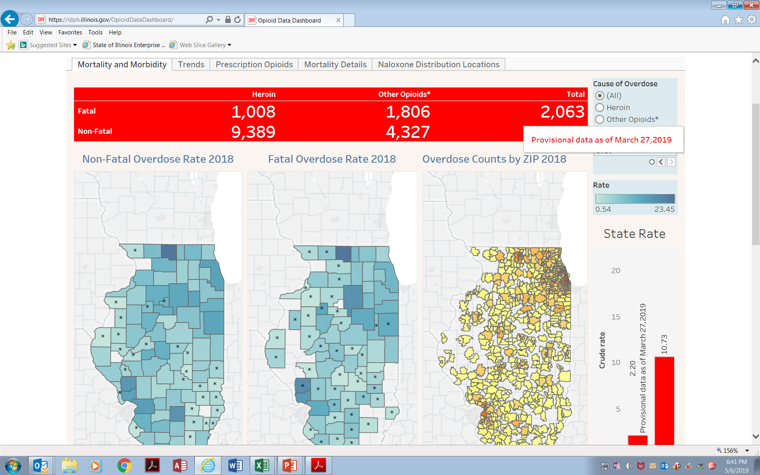
IDPH EMC Data
Mortality and Morbidity – Trends – Prescription Opioids – Naloxone Distribution
https://idph.illinois.gov/OpioidDataDashboard/

Slide 34
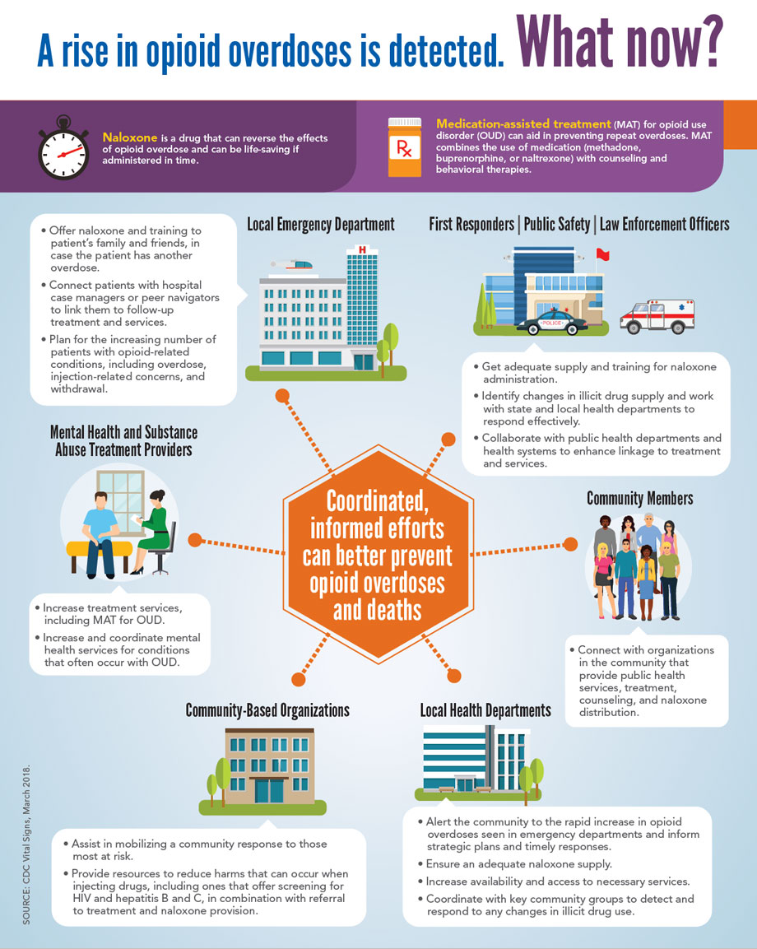

Slide 35

Division of Substance Use Prevention and Recovery (SUPR)
Single State Authority (SSA) charged with providing a system of care along the continuum of prevention, intervention, treatment and recovery support where individuals with SUD, those in recovery and those at risk are valued and treated with dignity and where stigma, accompanying attitudes, discrimination, and other barriers to recovery are eliminated
  Prevention
  Intervention
  Treatment for Substance Use Disorders (SUD) and other related disorders (gambling disorder)
  Recovery Support Services
Notes:
This integrated SUD service delivery system within DHS is coordinated by SUPR. These offices are primarily responsible for providing prevention, intervention and treatment services related to alcohol, tobacco and other drugs to citizens of Illinois.

Slide 36
SUPR Services Provided

Slide 37
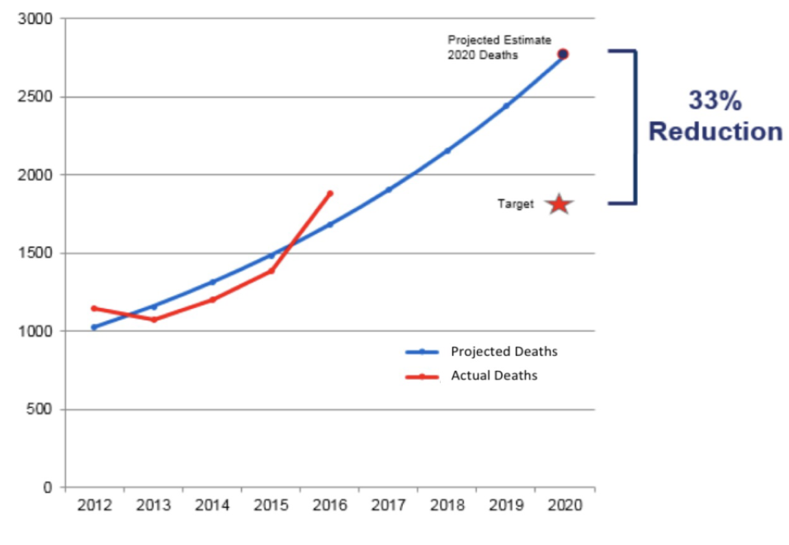
Statewide Opioid Action Plan (SOAP)
http://www.dhs.state.il.us/OneNetLibrary/27896/documents/SOAP.pdf
Goal
Notes:
SOAP strategies and the implementation plan have guided the Task Force’s and Council’s efforts to achieve the SOAP goal of reducing the number of projected opioid overdose deaths in 2020 by a third. Provisional IDPH numbers show a leveling out, even a slight decrease, from 2,202 fatal overdoses in 2017 to 2,063 in 2018.

Slide 38
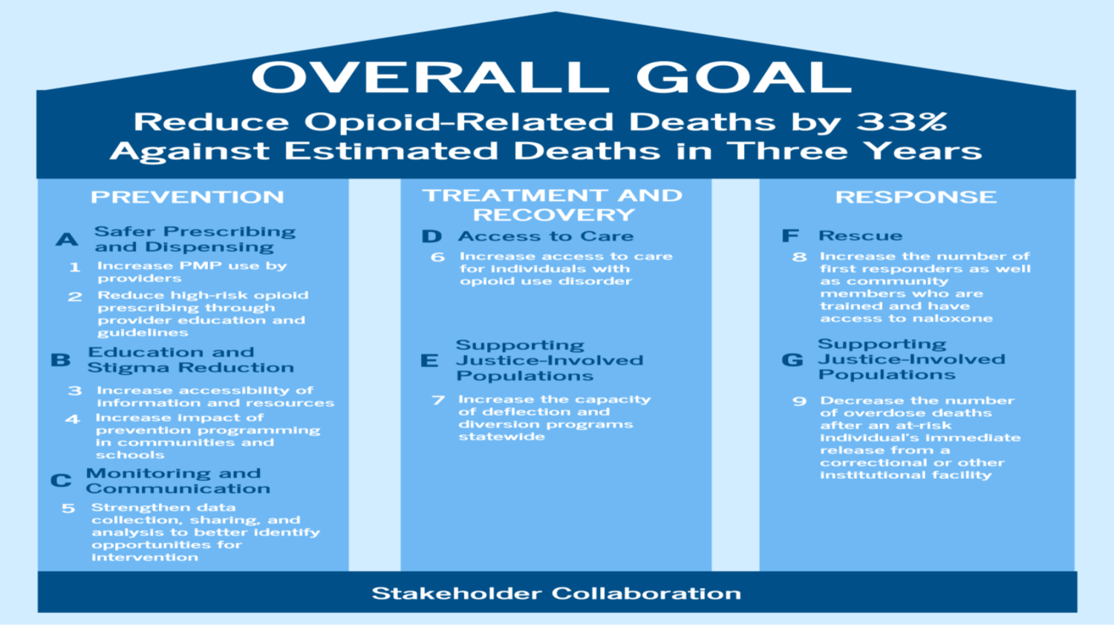
Statewide Opioid Action Plan (SOAP)
http://www.dhs.state.il.us/OneNetLibrary/27896/documents/SOAP.pdf
Notes:
The SOAP forms the strategic framework for addressing the opioid epidemic in Illinois, setting a statewide goal of reducing opioid- related deaths by one-third in three years and formulating a set of evidence-based strategies to achieve this goal. The SOAP focuses on efforts falling into three pillars:
1) Prevention: preventing people from using opioids
2) Treatment and Recovery: providing evidence-based treatment and recovery
services to Illinois citizens with opioid use disorder (OUD)
3) Response: avoiding death after overdose.
SOAP strategies and the implementation plan have guided the Task Force’s and Council’s efforts to achieve the SOAP goal of reducing the number of projected opioid overdose deaths in 2020 by a third. Provisional IDPH numbers show a leveling out, even a slight decrease, from 2,202 fatal overdoses in 2017 to 2,063 in 2018.

Slide 39
Ongoing Pillars to Programs
Notes:
The range of public awareness, prevention, outreach, MAT, and recovery support programs that are supported by these grants include a focus on the problematic use of prescription opioids as well as the use of illicit opioids such as heroin.

Slide 40

Illinois Helpline
Statewide 24-hour, 7-day/week, 365 day/year helpline for persons with OUD-related issues
The Helpline was launched on December 5, 2017 and has received 13,671 calls as of June 9, 2019.
The Helpline’s website was launched in March 2018 and has received 29,242 visits by 22,311 unique individuals as of June 9, 2019.
Notes:
Opioid Crisis Response Grant funds are being used to support a statewide 24-hour, 7-day/week, 365 day/year helpline for persons with OUD-related issues. The Helpline was launched on December 5, 2017 and has received
The Helpline was launched on December 5, 2017 and has received 13,671 calls as of June 9, 2019.
The Helpline’s website was launched in March 2018 and has received 29,242 visits by 22,311 unique individuals as of June 9, 2019.
Federal funding is being used to support expanded outreach services to increase the reach of the helpline and the companion website. These outreach services include bus and other transit promotional items, outdoor billboard advertising, and a social media strategy.
12,373 calls as of April 22, 2019. The Helpline’s website was launched in March 2018 and has received 24,892 visits by 18,908 unique individuals as of April 22, 2019. Federal funding is being used to support expanded outreach services to increase the reach of the helpline and the companion website. These outreach services include bus and other transit promotional items, outdoor billboard advertising, and a social media strategy.

Slide 41
What is Medication Assisted Treatment/Recovery (MAT)

Slide 42
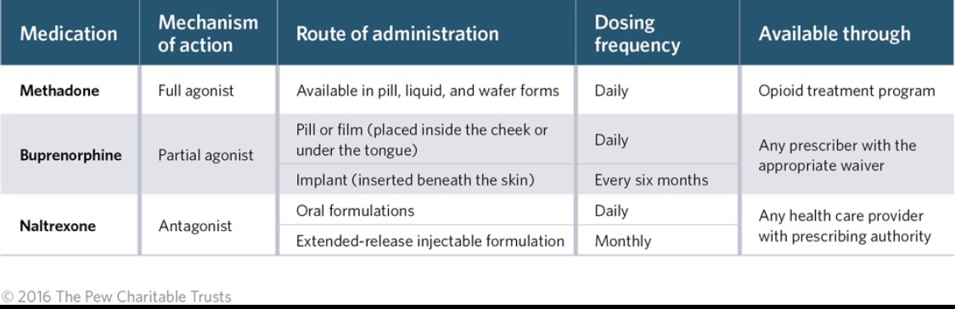
FDA Approved Medications Medication Assisted Treatment (MAT)
Agonist: a substance that fully activates the receptor that it binds to; Blocks the craving for opioids;
Antagonist: a substance that occupies the receptor but does not activate them; Blocks the effect of opioids;
Notes:
OMT services require certification by multiple federal agencies as an Opioid Treatment Program (OTP) and licensure by IDHS/SUPR
OMT services are regularly funded by a combination of Medicaid, Federal Substance Abuse Block Grant and state funds.
“Repeat overdoses may be prevented with medication-assisted treatment (MAT) for opioid use disorder (OUD), which is defined as a problematic pattern of opioid use,” Vital Signs states.
“EDs can provide naloxone, link patients to treatment and referral services, and provide health departments with critical data on overdoses.
ED data provide an early warning system for health departments to identify increases in opioid overdoses more quickly and coordinate response efforts.
EDs, health departments, mental health and treatment providers, community-based organizations, and law enforcement can prevent opioid overdose and death. – MAT and Naloxone

Slide 43
Reasons to choose Medication Assisted Treatment/Recovery
Source: SAMHSA website Decisions in Recovery: Treatment for Opioid Use Disorder

Slide 44
Effectiveness of Medication Assisted Treatment (MAT)
Opioid Use Disorder Treatment Retention Rates
Opioid treatment WITHOUT Medication Assisted Treatment (MAT) | 6%
Injectable Naltrexone | 10 – 31%
Buprenorphine | 60 – 90%
Methadone | 74 – 80%
Source: SAMHSA website Decisions in Recovery: Treatment for Opioid Use Disorder

Slide 45
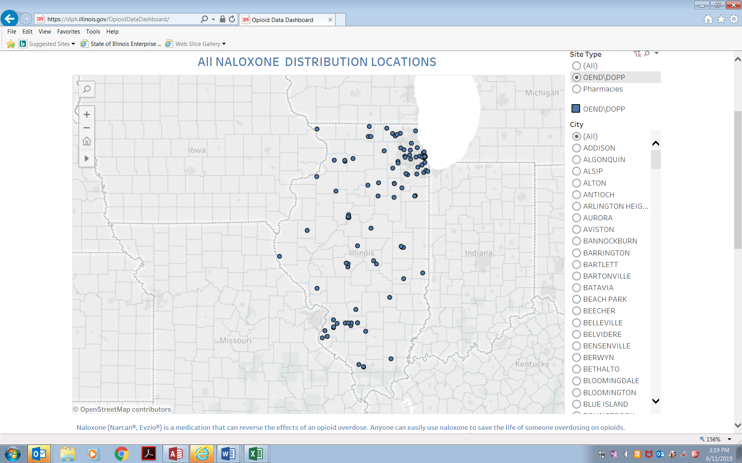
SUPR Statewide Naloxone Distribution Sites
Drug Overdose Prevention Program (DOPP)
117 DOPP OEND Programs as of 6.1.19

Slide 46
SUPR Drug Overdose Prevention Program (DOPP)
DOPP Enrollee Programs by Fiscal Year
Notes:
Potential enrollees include licensed SUPR Treatment Programs, recovery homes, licensed prescribing practitioners, for profit community-based organizations, not-for-profit community-based organizations, needle exchange programs, hospitals, police and sheriff departments, along with public health departments, health care providers, including FQHCs and health care for homeless clinics, urgent care facilities, faith-based organizations, public libraries, colleges and universities. The following agencies such as jails, prisons, probation and parole departments, problem-solving courts, are also encouraged to enroll as a Drug Overdose Prevention Program because they serve individuals who are at high risk of overdose. Programs are not required to be licensed by IDHS/SUPR.

Slide 47
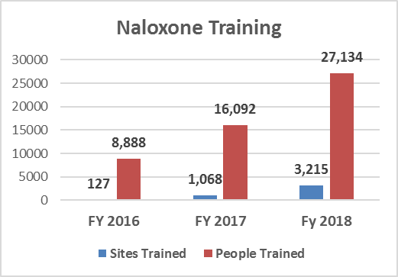
SUPR Drug Overdose Prevention Program (DOPP)
Expanded Naloxone Purchase/Training/Distribution Services
Naloxone is a medication that reverses an overdose by blocking opioids, including prescription opioids, synthetics like fentanyl, and heroin.
Federal funds are used for naloxone purchase, training, and distribution to traditional first responders like law enforcement officers and fire departments as well as non-traditional first responders like bystanders, friends, family members of heroin or other opioid dependent persons, and others.
Notes:
Nationwide, deaths involving opioids have plateaued and even fallen slightly in recent months, from an estimated high of 49,552 deaths in the 12-month period ending in September 2017 down to 48,612 in the period ending January of this year. While it’s too early to say whether that trend will continue through 2018, those numbers are somewhat encouraging.

Slide 48
SUPR DOPP
OVERDOSE
SAVES
DOPP Enrollment is a voluntary program
The training, saving and reporting is not mandated and is also voluntary.
DOPP data does not include Emergency Medical Service (EMS) saves which is published by Illinois Department of Public Health (IDPH) and located on their Data dashboard. https://idph.illinois.gov/OpioidDataDashboard/

Slide 49
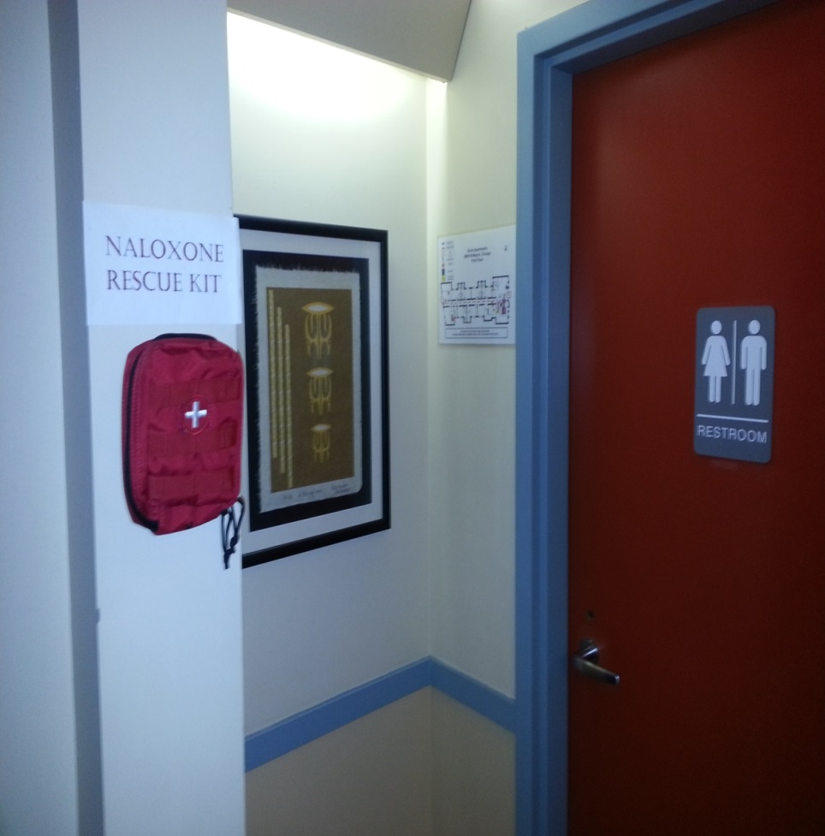
Notes:
These next couple of slides are real life physical plant examples of naloxone kits mounted and displayed at treatment programs and recovery homes.
Read- Notice easy to locate

Slide 50
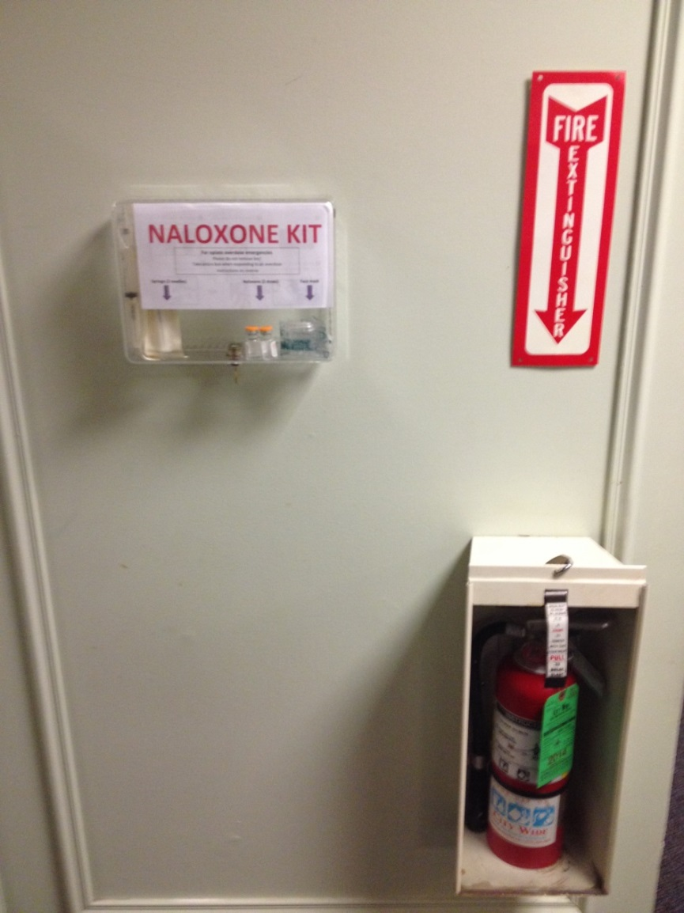
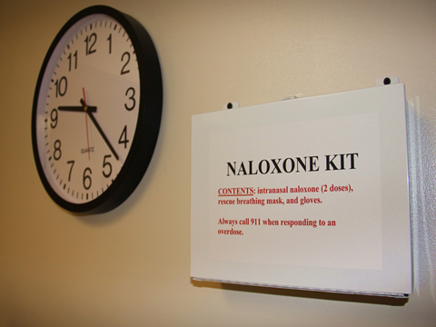
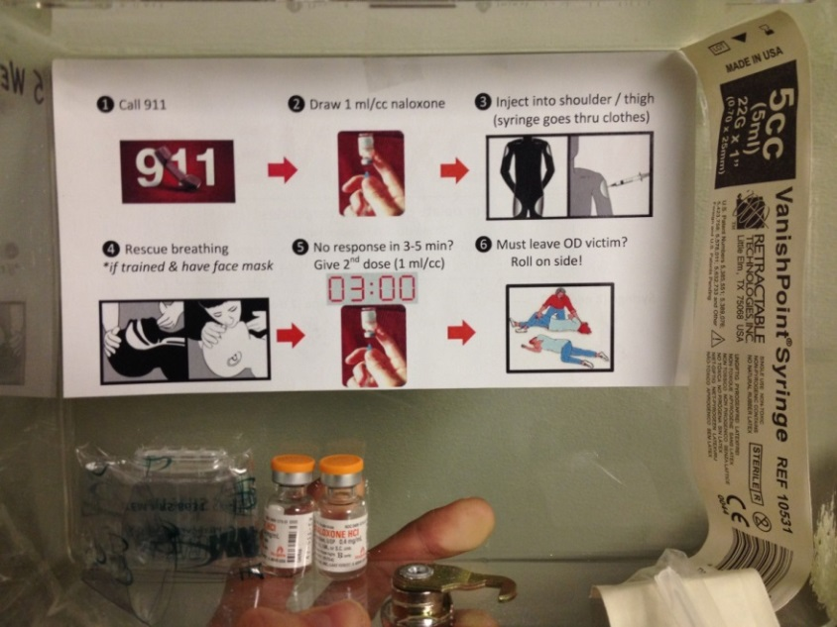
Examples of Mounted Kits
Slide courtesy of Maya Doe-Simkins, Chicago Recovery Alliance
Notes:
ROSIE/CAROLYN: :
Love this slide; Shows the naloxone kit and fire extinguisher in the same area – gives message that saving lives is a priority and and both mechanisms save lives.

Slide 51
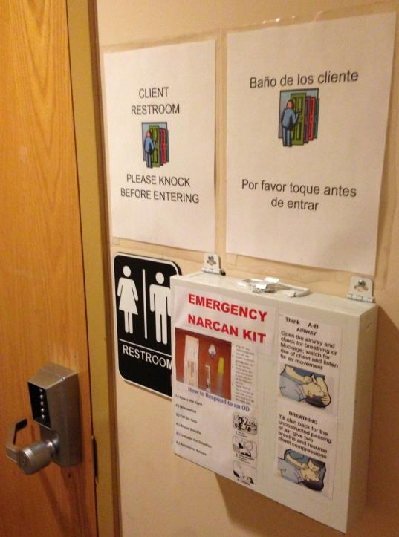
Maximizing Restroom Safety
Naloxone rescue kits
Emergency access to locked restroom
Gender neutral for single occupancy
Motion sensors
Syringe disposal box
Slide courtesy of Maya Doe-Simkins, Chicago Recovery Alliance
Notes:
Taking your time reduces over risk. Consider whether your door opens in our out. If it opens in, a person leaned against the door could prevent access.
Do not use lighting to try to deter people from injecting. It only makes it more likely they will harm themselves while trying to use drugs.

Slide 52
Naloxone Training
April Scales
Egyptian Health Department

Slide 53
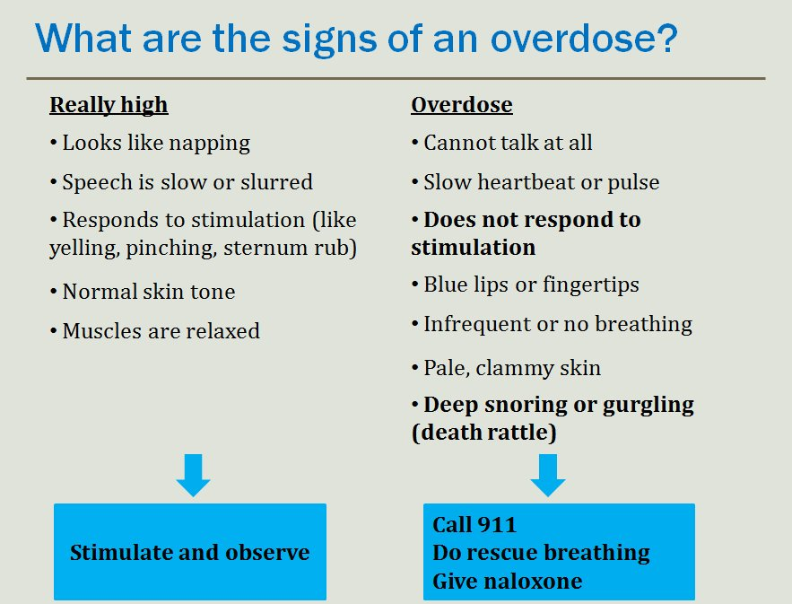

Slide 54
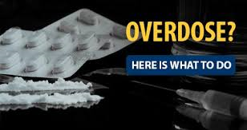

Slide 55
Responding to an Overdose:
*Stay Calm
*Call 911
*Shake the person, rub their sternum or forehead with knuckles
*Make noise; call the person’s name
*Perform Rescue Breathing and chest compression techniques (optional)
Notes:
Always talk to the victim of an overdose and tell them what you are doing. Rescue breathing is similar to CPR, however depending on the level of comfortability, rescue breathing can be done with or without mouth guard. We will have one provided to you along with your kits.

Slide 56
Rescue Breathing
Please review the steps below to perfect your rescue breathing technique:
  1. Place one hand on the person’s chin, tilt the
  head back.
  2. Pinch the nose closed.
  3. Place your mouth over the person’s mouth to make
  a seal and give 2 slow breaths.
  4. The person’s chest should rise (but not the stomach)
  5. Follow up with one breath every 5 seconds
  until the person can breath on their own

Slide 57
Responding to an Overdose
*ADMINISTER NALOXONE (NARCAN)
*Continue rescue breathing for 3-5 minutes
*Place person in Rescue Position once they are
breathing on their own

Slide 58
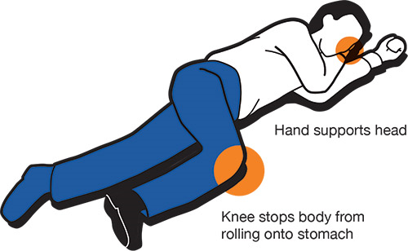
Rescue Position

Slide 59
Naloxone Facts
Once Naloxone is administered, the onset of action is about 2-3 minutes
Duration of action is 30 minutes to 2 hours, depending on method of administration and the intensity of opioid use and potency of opioid taken
It will NOT reverse an overdose caused by other drugs, only opioids
It is safe enough to use on children and pregnant women
Notes:
.Proper storage and maintenance of the naloxone supply is critical. Do not open product unless you are sure you need to use it. If you are unsure if the naloxone is expired, opened, or has been exposed to high or low temperature, contact the supplier and explain to them what has happened. If the product has not been stored properly or is past the expiration date, the product may not be fully effective.

Slide 60
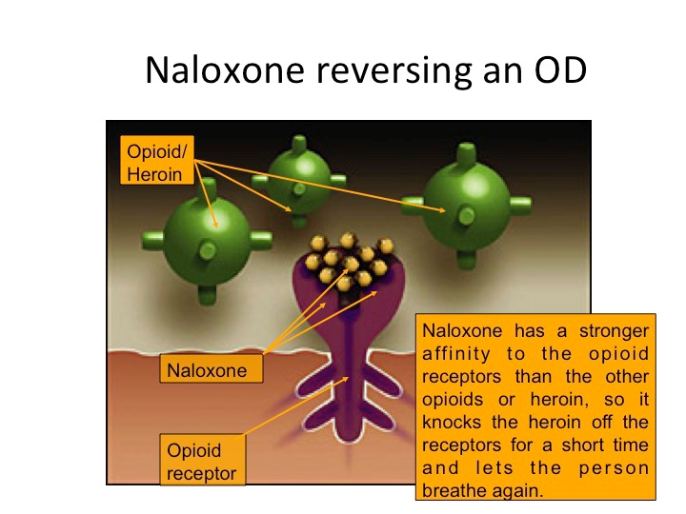
Notes:
The key is that the Naloxone only “kicks” the opioid off the brain receptor for a short period of time, allowing the Naloxone to fill in its place, blocking the receptor and allowing the person to breathe again. Emergency services should still be sought, as this is only temporary until additional medical attention is provided.

Slide 61
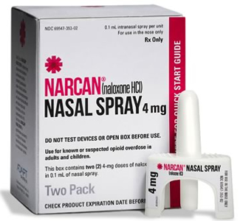
Naloxone Saves Lives!
Notes:
Naloxone “buys” time and saves lives. In 2015, Illinois passed legislation (HB1, now PA 099-0480) that increased the accessibility of Naloxone to non-medical persons to administer to individuals who may be experiencing an opioid overdose. The point of the legislation is to get this antidote in the hands of those who need it in order to save lives, first responders, family and/or friends of individuals who may use opioids, active opioid users, as well as people who were once opioid users and have been released from either from being incarcerated or in a in-house rehabilitation program.

Slide 62
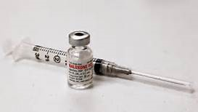
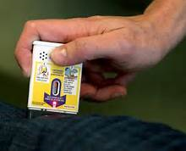
1. injected- Intravenously via a needle & syringe in upper arm or thigh
2. Auto-injection device- Intramuscular injection by a pre-filled, ready to use dose of medication which is administered by pressing against a person’s upper leg.
Ways Naloxone can be
Administered

Slide 63
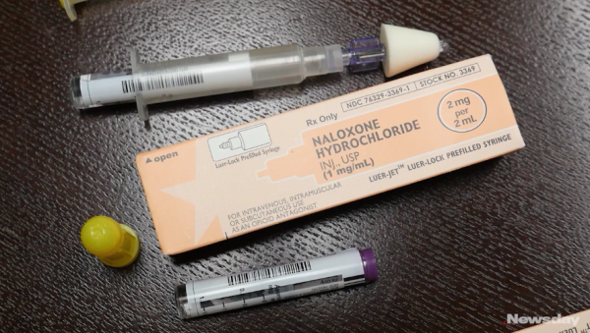
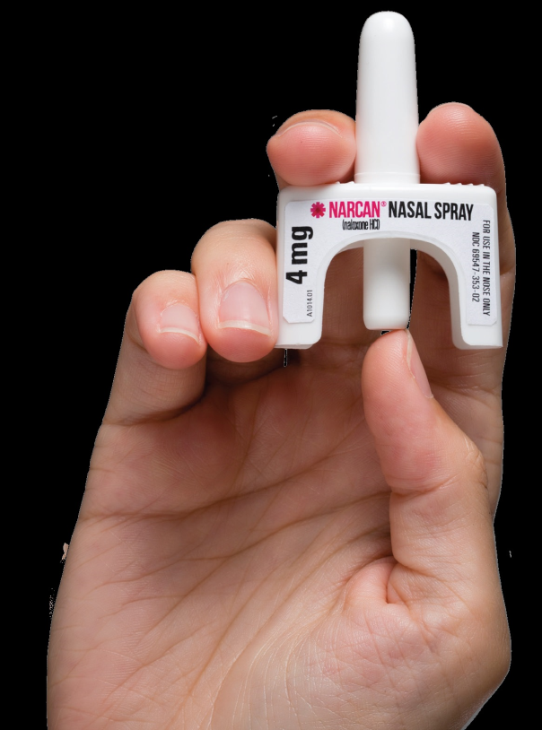
3. Nasal- Intranasal inhalation of medicine by spraying it into the nose
Notes:
The method that we are using and supplying to those in need is the intranasal Narcan spray device. There is no assembly necessary and the kit comes with two 4mg pre-filled doses of naloxone. (Show device here!) You gently insert the nozzle as far into the nostril until your fingers touch the person’s nostril and then firmly press the plunger, spraying an entire dose of Narcan into the nostril. If the person does not respond after the first dose, administer the second dose in the other nostril. This can be repeated as often as necessary if kits are available.

Slide 64
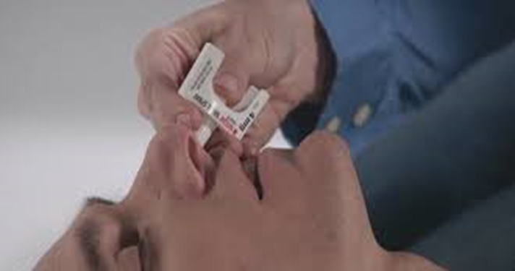
Why Intranasal Naloxone?
Very low risk of exposure to blood (no needles required)
Can be administered quickly with little training
Very effective when used
Notes:
Demonstrate use of Naloxone here! No pumping or priming is necessary! Simply plunge the device and the person has been administered 4mg of Naloxone.

Slide 65
More Facts about Naloxone
  Naloxone can be carried in your mode of transportation but should be stored in a temperature controlled environment.
  Pay attention to the expiration date for any naloxone product.
  Naloxone has a shelf life of 2 years.
  Expired naloxone can still be administered if there is no other alternative available. However, it may not be as effective and a second dose may be required.
Notes:
If only expired Naloxone is available, it can be used, but might not be as effective and an additional dose may be required.

Slide 66

Naloxone is only effective on opioid overdoses
Notes:
This cannot be stressed enough!!

Slide 67
https://www.youtube.com/watch?v=tGdUFMrCRh4
Naloxone/Narcan Video
Notes:
Stop video at 3:22

Slide 68
Naloxone Made Available
In 2015, HB 099-0480 was made a Public Act that opened access to and administration of naloxone by individuals other than first responders.
These services are supported by IDHS, Division of Substance Use Prevention and Recovery, as part of the Illinois State-Opioid Response (SOR) grant from the U.S. Dept of Health and Human Services, Substance Abuse and Mental Health Services Administration.

Slide 69
Good Samaritan Law
In 2012 the Illinois Public Act, 097-0687, The Good Samaritan Law, was passed and it protects people from drug possession charges if they witness or experience an overdose and call 911 for help. (specified limitations apply)
The immunity applies to any “good faith effort” made to seek emergency medical help, whether that is calling 911, or taking the overdose victim to an emergency room.
9-11% decrease in overdose deaths since the passing of the GSL.
Notes:
The “Good Samaritan Law” protects the caller and/or the person who takes an overdosing individual to the ER from any possession charges and from being prosecuted, as long as they are acting in “good faith” to assist someone who may be experiencing an overdose. It is ALWAYS is best to call 911 in the event of an overdose. Only the caller and the overdosing person receive protection. The “GSL” however does NOT provide immunity to people who sold or gave the drugs to the overdosing person.

Slide 70
NALOXONE in the hands of those who need it most!
NUMBER ONE priority: Put Naloxone (Narcan) in the hands of those most likely to be on the scene and/or first to respond to those who are experiencing an overdose:
Law Enforcement
Other first responders
School personnel
Individuals who use opioids themselves
Friends of family members
People working around active users
People being released from incarceration and/or treatment facilities
Notes:
It is imperative that Naloxone gets in the hands of those who are most in need. It should be in the first aid kit of every lay and professional first responder: in police cars, ambulances, homeless shelters, substance use treatment programs, schools, community centers and home first aid kits. DOPP supported by IDHS and DASA such as this, demonstrate just how committed those agencies are to achieving that mission.

Slide 71
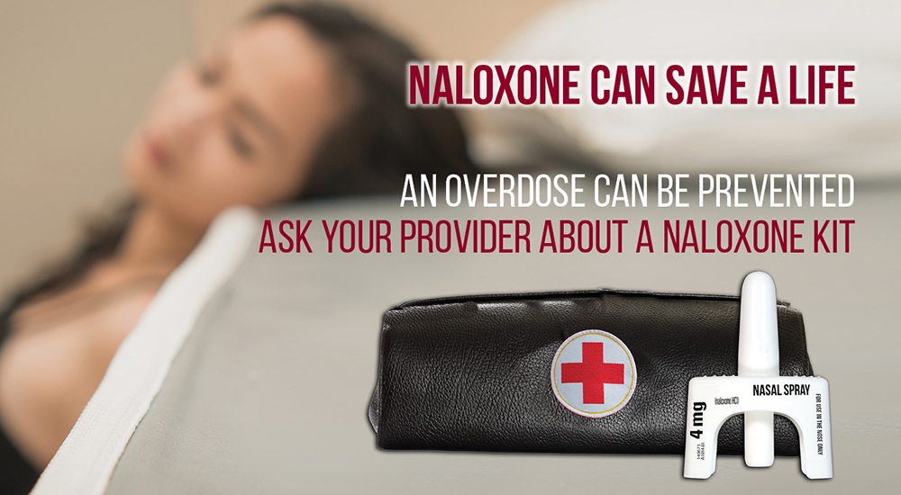

Slide 72

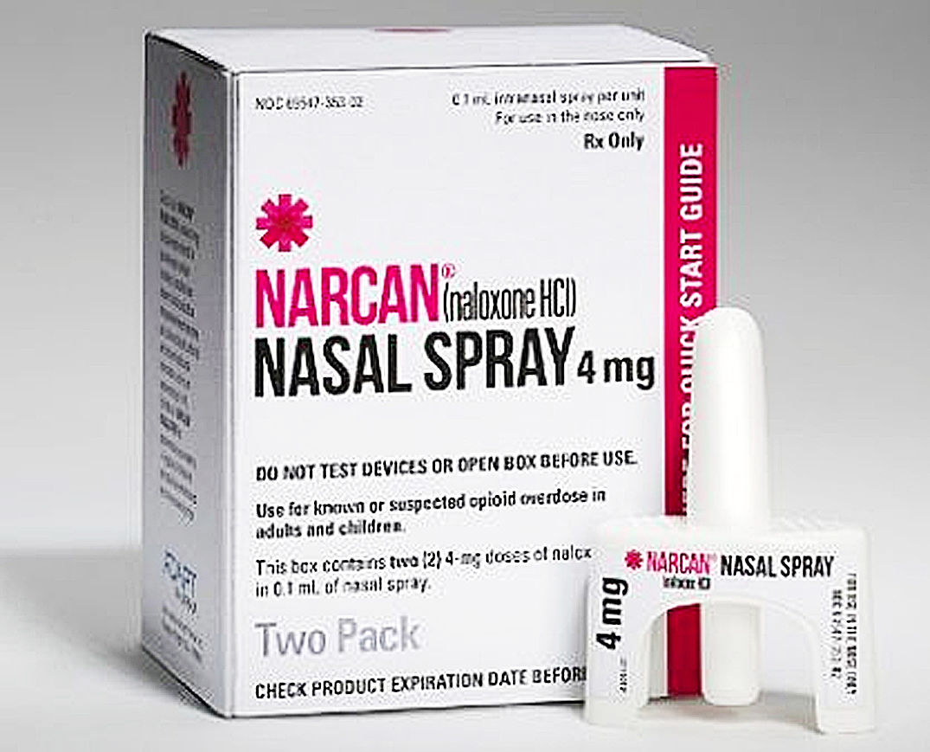
Standing Order

Slide 73
Be Prepared,
Get Naloxone,
Save a Life!

Slide 74
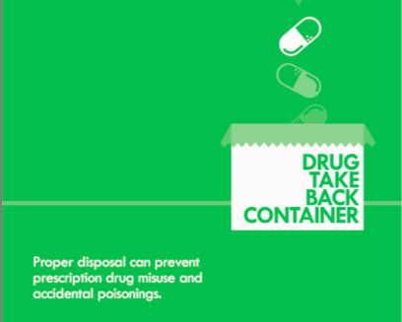
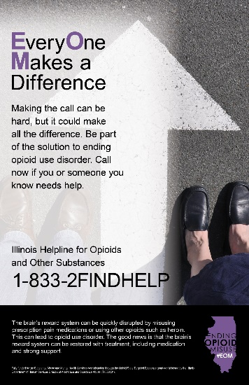
Public Awareness Campaigns
Guard and Discard –Focuses on importance of safe use, storage and disposal of prescription pain medications
Ending Opioid Misuse in Illinois (#EOM) - Targets individuals who are misusing opioids as well as their friends, families, and communities, using non-stigmatizing messaging.
A Dose of Truth - Creates base knowledge in the general population about what opioids are.
Notes:
Public awareness approaches are underway to deliver messaging and education to various audiences regarding the impacts of the opioid crisis in Illinois and the availability of programs and activities that have been developed in response.
Messages are in both English and Spanish.

Slide 75
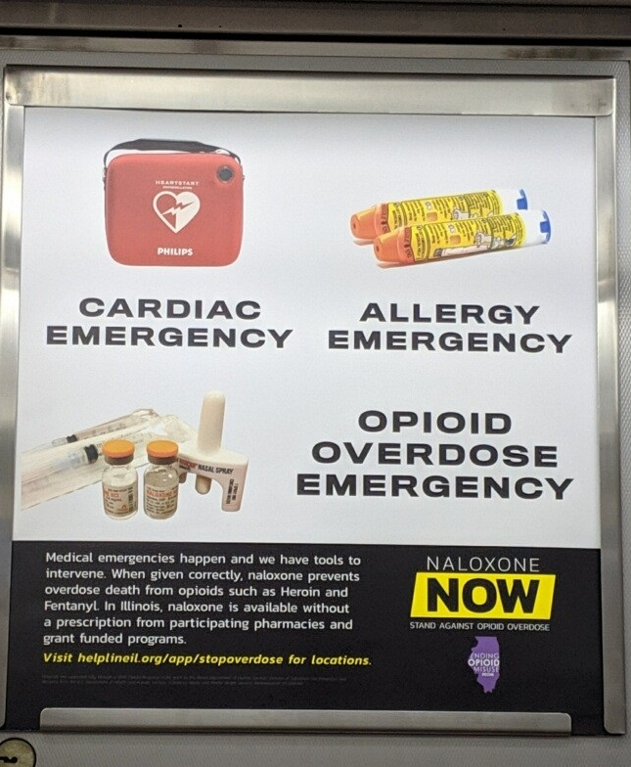
Naloxone Public Awareness

Slide 76
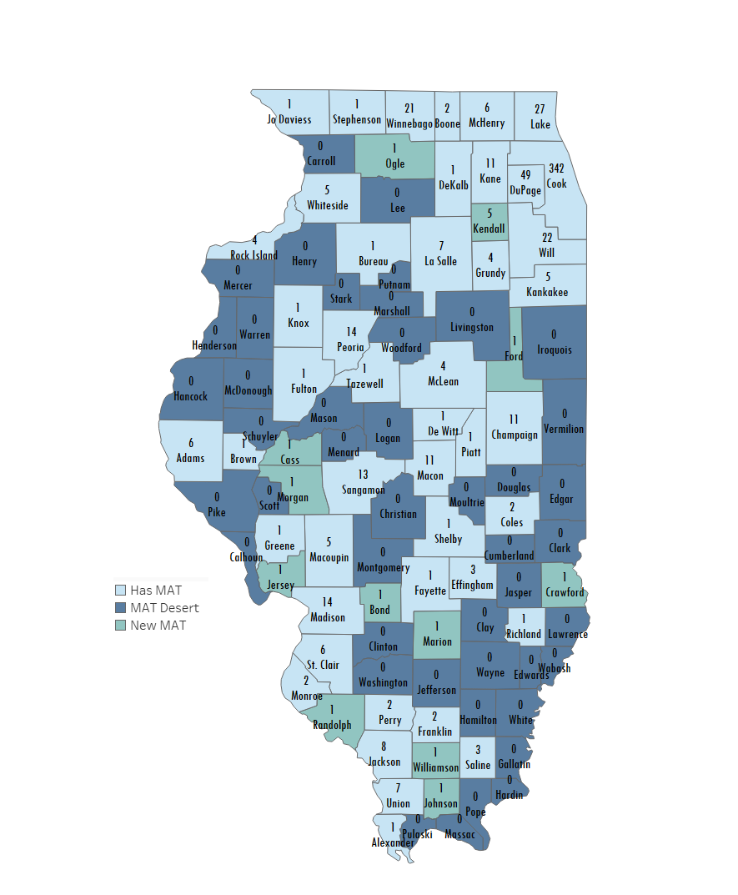
Illinois MAT Map

Slide 77
What is the Access to Medication Assisted Treatment (A-MAT) Network?
SAMHSA technical assistance, combined training and coaching for new Hub & Spoke sites. Focus on model implementation and development of MAT Team. Clinical training for key staff.
http://www.dhs.state.il.us/page.aspx?item=115412
Notes:
We are adapting this model for our work in rural Illinois.
Increase the availability of evidence-based information, outreach, linkage/referral, medication-assisted treatment, and recovery support services that are available for Illinois residents with opioid use disorders (OUD). The focus will be on those geographic areas that are "MAT deserts", having no access to any forms of MAT.
Five sites have been funded: Two began in November 2018 and three in March 2019.
SAMHSA technical assistance, combined training and coaching for new Hub & Spoke sites. Focus on model implementation and development of MAT Team. Clinical training for key staff.
Rush University Opioid Use Disorder Treatment Fellowship Program- Immersion Weekend Training; Introduces evidence-based SUD treatment options as well as basics of administrative leadership and systems design (i.e. hub & spoke models). Includes ongoing monthly group case conferences and access to expert faculty for individual case discussions and program reviews (coaching).

Slide 78
HUB and SPOKE Model = AMAT
Notes:
Everywhere recognized – Evidenced Based Practice

Slide 79
Expanded Outpatient Methadone Treatment (OMT) Services

Slide 80
Opioid Crisis Response Grants (OCR)
http://www.dhs.state.il.us/page.aspx?item=105980
Notes:
The programs supported through these Opioid Crisis Response Grants are designed to address the range of serious opioid-related problems and issues that are being experienced among residents across Illinois. These programs primarily aim to address the opioid crisis by expanding the availability of medication assisted treatment (MAT), improving the quality of the MAT provided, reducing opioid overdose related deaths, and increasing public awareness of opioid-related problems and access to the resources that are available to address these problems. The range of public awareness, prevention, outreach, MAT, and recovery support programs that are supported by these grants include a focus on the problematic use of prescription opioids as well as the use of illicit opioids such as heroin.

Slide 81
Recovery Oriented Systems of Care
A ROSC is a coordinated network of community based services and supports that is person-centered and builds on the strength and resilience of individuals, families, and communities to achieve abstinence* and improved health, wellness and quality of life for those with or at risk of alcohol and drug problems.
*Note that abstinence is in the SAMHSA ROSC definition, but others have replaced “abstinence” with “recovery”.
https://www.samhsa.gov/sites/default/files/rosc_resource_guide_book.pdf

Slide 82

Recovery Oriented System of Care (ROSC) Goals:
Building a culture that builds and nurtures recovery
Building capacity and infrastructure to support a recovery-oriented system of care
Developing commitment to implement and sustain a recovery-oriented system of care
IDHS/SUPR ROSC Page: http://www.dhs.state.il.us/page.aspx?item=99995
Notes:
In Illinois, we have been working on better defining what recovery looks like and developing a shared vision statewide, building capacity in our communities and developing policy and billing systems, as well as staffing at the state level and getting everyone on board to support our ROSC
We are aiming to move from this chronic model of addiction treatment, where, if you’re familiar with the forest metaphor, we basically dig up a sick and dying tree, transplanting it into a healthy forest with rich soil, sunshine, water and fertilizer, but then once the tree is thriving again return it to its original location where it was deprived and unhealthy. Instead we need to be treating the soil, create a Healing Forest around where the individual and their family resides, adding resources to the community, and working together to create a recovery-ready community.

Slide 83

Illinois
ROSC-ISN Map
Notes:
Locally, this has involved building capacity by forming ROSC Councils to lead the development of recovery-ready communities.
This past year, we have supported a Lead agency in each of 8 communities that convenes a council whose purpose is to improve the local ROSC.
Council membership includes individuals that live in the community as well as local hospitals, primary care, mental health, law enforcement, local business owners, local government representatives and policy makers, persons with lived experience and SUD intervention, treatment, prevention and recovery support service providers.
Over the first year, they are required to build their roster, conduct a needs assessment, develop a strategic plan, including an outreach and communications plan, and develop goals that will guide them through the next five years. During this time we will continue to support them, while developing additional ROSC councils throughout the state. Experienced ROSCs will serve as mentors and guides for new ROSCs by sharing lessons learned and perhaps more formal mentor ships as the project progresses. They will also contribute to the statewide ROSC, as local representatives. Instrumental in this project has been our collaboration with the local ATTC, the Great Lakes ATTC, in their project management and technical assistance. TA has included coaching and learning collaboratives
So we are developing collaboration within a community, between communities, statewide and learning from what other states have done through the ATTC.
We began this process with 8 communities in FY 2019 and we’re expanding, hopefully we’ll get another 6 – 10 communities on board in FY 2020.

Slide 84
IDHS/SUPR
Opioid Resources
http://www.dhs.state.il.us/page.aspx?item=93882
DOPP
http://www.dhs.state.il.us/page.aspx?item=58142
Monthly OCR Update
http://www.dhs.state.il.us/page.aspx?item=105980
NOFOs
http://www.dhs.state.il.us/page.aspx?item=114615

